Slide 1
Basketball

Slide 2
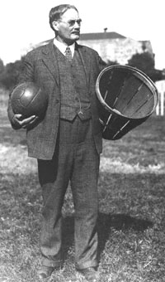
Invention of the Game
James Naismith was a Canadian teacher, born in Almonte, Ontario on the 16th of November, 1861.
Massachusetts had cold winters, and people wanted a game that could be played inside.
James Naismith

Slide 3
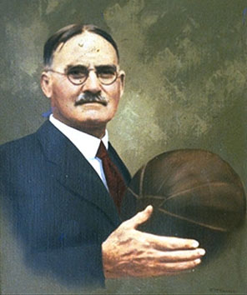
Invention of the Game
Physical educator Luther Gulick asked him to invent a new indoor game, which could be played during the cold winter.
Made it for a physical education class to play.
Started in December of 1891.
He wrote that he took some ideas from other sports: when he was young, he played with his friends a game called "Duck on a Rock." In this game, one boy guarded his “duck” from the stones of the others; and the fun began as the boys gathered their stray shots. It was this game that was later to play such an important part in the origin of basketball.
The first game was played on December 29, 1891.

Slide 4
The First 13 Rules of Basketball
The ball may be thrown in any direction with one or both hands.
The ball may be batted in any direction with one of both hands, but never with the fist.
A player cannot run with the ball. The player must throw it from the spot on which he catches it, allowance to be made for a man running at good speed.
The ball must be held by the hands. The arms or body must not be used for holding it.
No shouldering, holding, pushing, striking or tripping in any way of an opponent. The first infringement of this rule by any person shall count as a foul; the second shall disqualify him until the next basket is made or, if there was evident intent to injure the person, for the whole of the game. No substitution shall be allowed.
A foul is striking at the ball with the fist, violations of rules 3 and 4 such as described in rule 5.

Slide 5
The First 13 Rules of Basketball
If a side makes three consecutive fouls it shall count as a goal for the opponents (consecutive means without the opponents in the meantime making a foul).
A basket shall be made when the ball is thrown or batted from the grounds into the basket and stays there, providing those defending the goal do no touch or disturb the goal. If the ball rests on the edges, and opponent moves the basket, it shall count as a goal.
When the ball goes out of bounds, it shall be thrown into the field and played by the first person touching it. In case of dispute the umpire shall throw it straight into the field. The thrower-in is allowed five seconds. If he holds it longer, it shall go to the opponent. If any side persists in delaying the game, the umpire shall call a foul on them.
The umpire shall be the judge of the men and shall note the fouls and notify the referee when three consecutive fouls have been made. He shall have power to disqualify men according to Rule 5.
The referee shall be judge of the ball and shall decide when the ball is in play, in bounds, to which side it belongs, and shall keep the time. He shall decide when a basket has been made and keep account of the goals, with any other duties that are usually performed by a referee.
The time shall be two fifteen-minute halves, with five minutes' rest between.
The side making the most goals in that time shall be declared the winner.

Slide 6
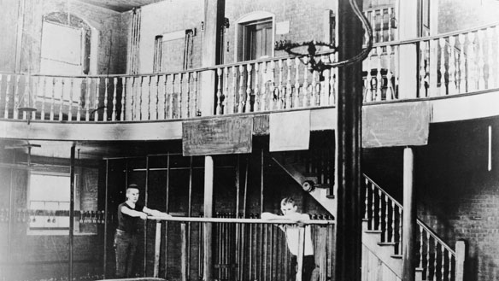
The First Basketball Game
December 29, 1891
9 versus 9, using a soccer ball and two peach baskets.
Frank Mahan, one of his students, wasn’t so happy. He just said: "Huh. Another new game".
Someone proposed to call it “Naismith Game”, but he suggested "We have a ball and a basket: why don’t we call it basket ball”?
The final score was 1–0.

Slide 7
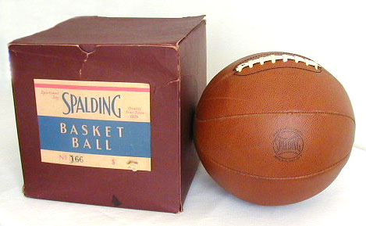
The First Basketball Game
The peach baskets were closed, and balls had to be retrieved manually by cutting a small hole in the bottom of the peach basket and poking the ball out using a stick.
1906 metal hoops, nets, and boards were introduced.
The soccer ball was replaced by a Spalding ball
Finally, the players could not move with the ball because they had to pass it, without dribbling around or past the opponents, as is common today.

Slide 8
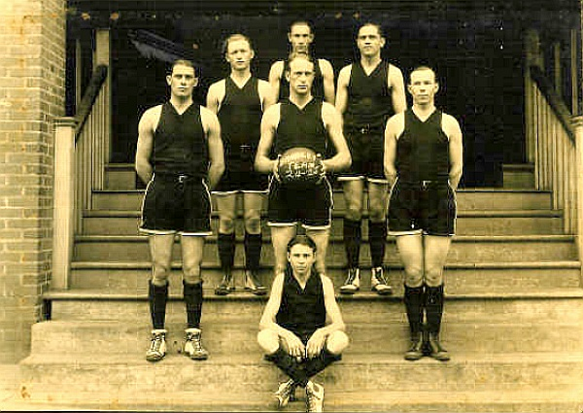
YMCA, U.S. Army Spread Development
The YMCA that had a major role in spreading basketball throughout the United States and Canada, and then throughout the world.
1893, Mel Rideout arranged the first European match in Paris.
At the same time, Bob Gailey went to Tientsin, China (1894), Duncan Patton to India, Genzabaro Ishikawa to Japan, and C. Hareek to Persia.
1924-1925 Warren YMCA Basketball Team

Slide 9
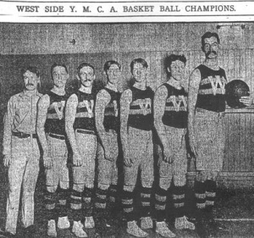
YMCA, U.S. Army Spread Development
The First World War broke out in 1914, and the U.S. Army started fighting in Europe in 1917.
During World War I, American Expeditionary Force brought basketball wherever they went.
Together with the troops, there were hundreds of physical education teachers, who knew basketball
James Naismith spent two years with YMCA in France.

Slide 10
Professional Leagues, Teams, and Organizations
The first professional league was founded in 1898.
Six teams took part in the National Basket Ball League, and the first champions were the Trenton Nationals, followed by the New York Wanderers, the Bristol Pile Drivers and the Camden Electrics.
The league was abandoned in 1904.

Slide 11
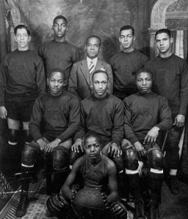
Professional Leagues, Teams, and Organizations
The Original Celtics are considered the "fathers of modern basketball"
The players had to sign a contract to play with them and the manager, Jim Furey, organized matches as a circus, moving daily from town to town.
The Celtics became the strongest team, and their successes lasted from 1922 until 1928.
The Original Celtics are sometimes incorrectly thought of as forebears of the current Boston Celtics of the NBA
Today's Celtics were not founded until 1946, nearly two decades after the demise of the Original Celtics.
In 1922, the first all-African American professional team was founded: The Rens (also known as New York Renaissance or Harlem Renaissance).
The Rens were the Original Celtics’ usual opponent
The team disbanded in 1949.

Slide 12
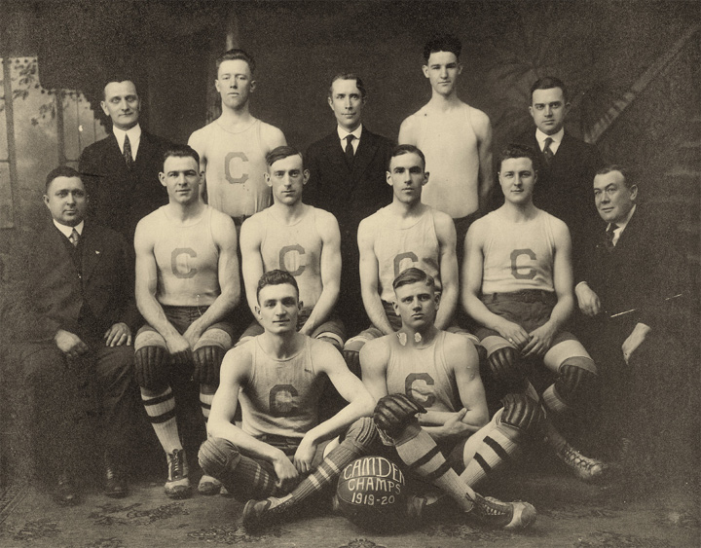
Professional Leagues, Teams, and Organizations
Most important leagues.
Eastern Basket Ball League- founded in 1909
Metropolitan Basketball League- founded in 1921
American Basketball League- founded in 1925
Camden Crusaders 1919-1920
Eastern Basketball League Champs

Slide 13
American Colleges Lead the Way
First game which involved at least one college team was between Geneva College and New Brighton, YMCA, on April 8, 1893, in Beaver Falls, Pennsylvania
Geneva College calls itself "The Birthplace of College Basketball".
February 1895, Minnesota State School of Agriculture and Hamline University played the first intercollegiate match .
1905 some universities created the Intercollegiate Athletic Association, which become National Collegiate Athletic Association (NCAA) in 1908.
The NCAA created a United States championship in 1939, adding the playoffs at the end of each conference.

Slide 14
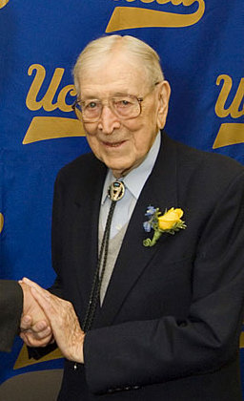
John Wooden
The "Wizard of Westwood”
Won ten NCAA national championships in a 12-year period — seven in a row
His teams won a then-record 88 consecutive games.
Named national coach of the year six times

Slide 15
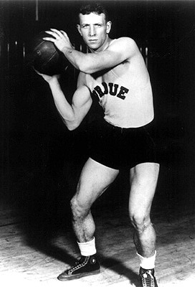
John Wooden's Seven Point Creed:
Be true to yourself.
Make each day your masterpiece.
Help others.
Drink deeply from good books, especially the Bible.
Make friendship a fine art.
Build a shelter against a rainy day.
Pray for guidance and give thanks for your blessings every day.

Slide 16
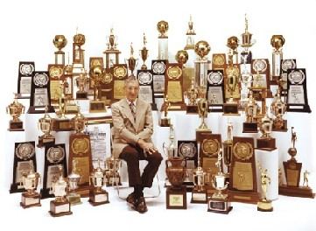
Among Wooden's maxims:
Failing to prepare is preparing to fail.
Flexibility is the key to stability.
Be quick, but don't hurry

Slide 17
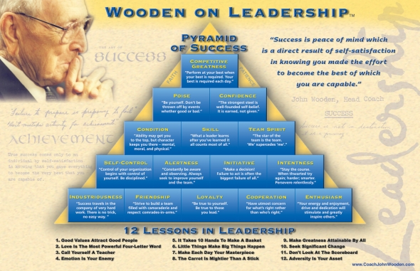

Slide 18
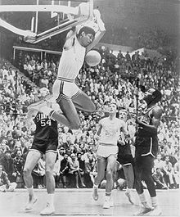
UCLA Dynasty
UCLA men's basketball NCAA records.
11 NCAA titles
7 consecutive NCAA titles (1967–1973)
13 NCAA title game appearances
18 Final Four appearances*
10 consecutive Final Four appearances (1967–1976)
26 Final Four wins*
38 game NCAA Tournament winning streak (1964–1974)
134 weeks ranked #1 in AP Top 25 Poll
221 consecutive weeks ranked in AP Top 25 Poll (1966–1980)
54 consecutive winning seasons (1949–2002)
88 game men's regular season winning streak (1971–1974)
4 Perfect undefeated seasons, 1964, 1967, 1972, 1973
Kareem Abdul Jabbar

Slide 19
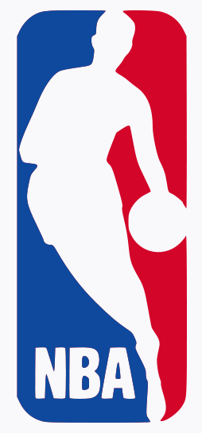
NBA Founded
Founded in New York City on June 6, 1946
Original name was the Basketball Association of America (BAA).
The league adopted the name National Basketball Association (NBA) in 1949 after merging with the rival National Basketball League (NBL).

Slide 20
1950-60’s NBA
With the United States experiencing economic growth in the 1950’s, many Americans had expendable incomes so they turned to consumerism, sports, and athletes as a way to spend their time and money
Some of the early stars and teams of the 1950’s and 1960’s were

Slide 21
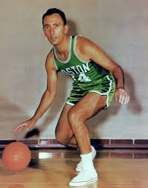
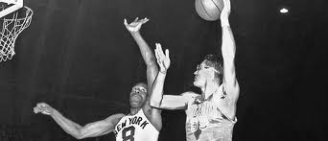
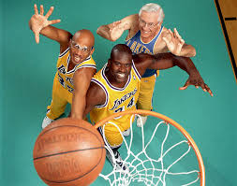
1950’s Stars
Bob Cousy
1950’s
Paul Arizin
Dominant Teams
Milwaukee Lakers 49, 50, 52-54
Boston Celtics 57, 59
St. Louis Hawks 58
Philadelphia Warriors 47, 56
Syracuse Nationals 55
New York Knicks
George Mikan

Slide 22
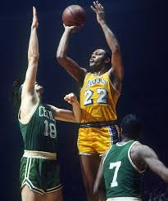
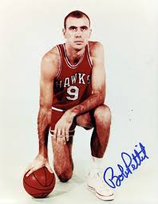
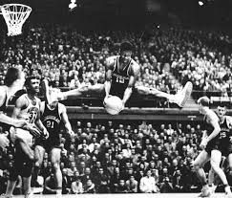
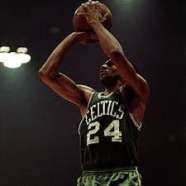
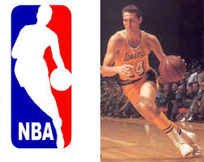
1960’s Stars
1960’s
Celtics Won 9 of the 10 Championships (67 76ers)
6 of them were against the Lakers

Slide 23
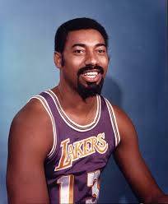
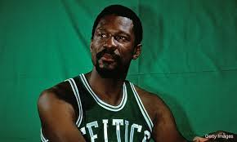
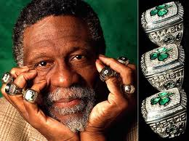
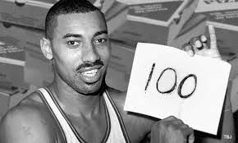
Bill Russell vs. Wilt Chamberlain

Slide 24
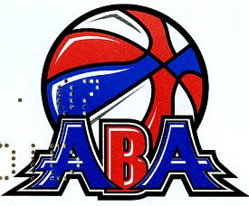
American Basketball Association
founded in 1967, competing with the National Basketball Association, until the ABA–NBA merger in 1976.
ABA’s long-term goal was to force a merger with the more established league.
ABA officials told potential owners that they could get an ABA team for half of what it cost to get an NBA expansion team at the time.

Slide 25
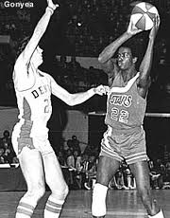
1970-1971 Champions
Moses Malone

Slide 26
1976 NBA - ABA Merger
NBA and ABA merge
Only 4 teams from the ABA became NBA teams
Indiana Pacers
Denver Nuggets
San Antonio Spurs
New York Nets

Slide 27
1970’s Basketball
With the 1970’s and the ABA Merger came new problems to the NBA
Smaller Talent Pool 6 teams to 14 (30 today
Drugs
Not selling out
Teams Moving
Too Individual
Too Black

Slide 28
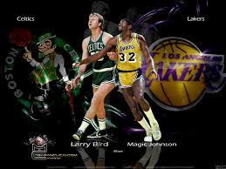
1980
We Need a Hero
Magic and Larry

Slide 29
NBA reaches a New Level 80’s-90’s
Rivalries
Star Players

Slide 30
Jordan Era

Slide 31
New Media and NBA today

Slide 32
Lockout

