Slide 1
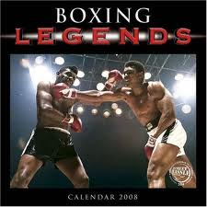
BOXING

Slide 2
Boxing Definition and Beginnings
Boxing means two people punching each other
Boxing is considered by many to be the oldest sport
Greeks are credited with inventing Boxing with the first know boxing match in 688 BCE in the Olympic Games
Romans also Boxed in the Roman Empire using specialized gloves designed to seriously hurt or kill your opponent

Slide 3
A Workman’s Sport
Boxing is considered a sport for the common working class man.
The British revived the sport in the early 1700’s
In the United States it became popular as new Immigrant groups from England, Ireland, and Germany moved into the country
Teddy Roosevelt used Boxing as a sport to increase his strength and stamina and continued into his presidency he even broke a few ribs boxing while president.

Slide 4
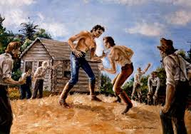
The Bareknuckle Era
From the early 1700’s until 1867 fighters didn’t use gloves were allowed to hit below the belt and hit a fighter while on the ground

Slide 5
Modern Era Boxing
In 1867 in London the Marquess de Queensbury set of 12 rules were instituted and rule the modern game of Boxing. Some rules include
A Square Ring
3 minute rounds
1 minute rest between rounds
10 second count
Gloves

Slide 6
Amateur Boxing
In 1904 the Olympics reinstituted Boxing as an official sport and to this day only Amateurs are allowed to fight in the Olympics.
The biggest achievement for an Amateur Boxer is to win a gold medal.

Slide 7
Professional Boxing
The are different title belts and weight classes. The most famous and best of the fighters are considered to come from the Heavy Weight Class

Slide 8
Top American Fighters
The following is a list of some of the Best American Champion Boxers in Chorological order. It is hard to say who is the greatest off all time because each was dominant during their era.

Slide 9
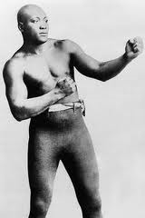
Jack Johnson
1908-1915
73 (40)-13-9
Heavy Weight
First African American Champ
Very brash and bold, didn’t
like to knock out opponent
so he could keep humiliating
them.
Angered White American and caused
many race riots because of his victories,
and received hundreds of death threats.

Slide 10
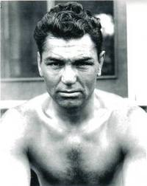
Jack Dempsey
1919-1926
66 (51)-6-9
First million dollar fighter
Grew up poor in Utah and
became famous by getting
into bar fights.
Opened a very successful
New York restaurant after
retiring from Boxing

Slide 11
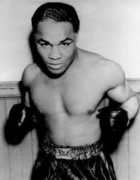
Henry Armstrong Jr.
1936-1939
150(100)-21-9
Only boxer to hold three
different championship
belts at the same time
Feather weight
Light weight
Welter weight

Slide 12
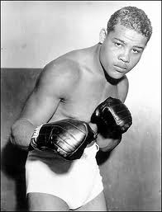
Joe Lewis
1937-1949
66(52)-3
Brown Bomber
Only legitimate loss was
to German Max Schemiling.
Who he would later beat
during WWII.
Donated all winnings to the United States during WWII

Slide 13
Joe Lewis (continued)
Donated all winnings to the United States during WWII
Is a Symbol of pride and hope to black Americans and all Americans during WWII
Considered by many to be the Greatest Boxer of All-time and first Black Athlete to make Celebrity status
Because of Tax problems he dies completely broke and a Casino Greeter in Las Vegas
http://www.youtube.com/watch?v=6BLGdFQPh8c

Slide 14
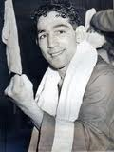
Willie Pep
1942-1952
229(65)-11-1
Feather weight champ
26 year career
Won 73 fights in a row
1947 got in car crash and
nearly died but returned to
defend title
Retired from Boxing in 1960

Slide 15
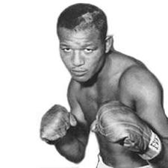
Sugar Ray Robinson
Champ between 1946-1960
173(109)-19-6
Considered by most
historians to be the
greatest pound for
pound boxer of all time
Also a great singer,
dancer and entertainer in Harlem
Famous for never giving up and having the best competition of any fighter in history

Slide 16
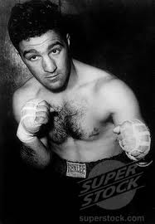
Rocky Marciano
1952-1955
49(43)-0
Only Undefeated Boxer in
American History
Great Athlete
Known for overpowering
opponents
Died in a Airplane crash in 1969

Slide 17
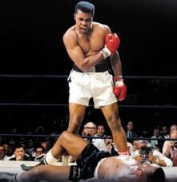
Muhammad Ali
1964-67,71-75
56(37)-5
Cassius Clay, until
converted to Islam.
Heavily influenced by
Malcolm X.
At age of 22 knocked
out Sonny Liston to
be the youngest Champ in History

Slide 18
Ali (continued)
Put in Prison from 67-70 for refusing to enter the Vietnam War.
Became a voice of protest specking out against racism and the Vietnam War.
“No Vietcong ever called me N****r.”
Came back into the ring in 71 and won back the title and defended his title in some of the greatest fights in American History. Norton, Frazier, Forman Spinks. Etc.

Slide 19
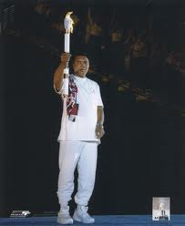
Ali today
Ali once a controversial
American figure is a beloved
American Hero.
Suffers from Parkinson
Syndrome
Lit the Olympic Torch in the 1996 Atlanta Olympic Games

Slide 20
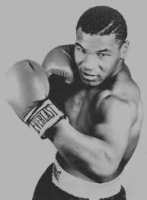
Mike Tyson
1988-90, 96
50(44)-6
Iron Mike Tyson
Known for being the
most intimidating fighter
in History
In prison from 1992-95
97 bit Evander Holyfield
banned from many arenas
2003 Declared Bankrupt despite making
300 million in his fighting career
Retired in 2007, has been in reality shows and movies

Slide 21
Future of Boxing in the U.S.
Boxing Historians all agree that Boxing is currently at its lowest point in modern History, but most agree that all it needs is one prized fighter to bring the sport back.
Others disagree saying that boxing is being replaced by a more intense and brutal style of fighting called MMA (Mixed Martial Arts). Most boxing enthusiasts believe that Boxers would dominate an MMA fighter and do not consider it on the same level of Boxing.
Currently MMA is growing in popularity and is certainly more popular than Boxing

