Slide 1
College Football

Slide 2
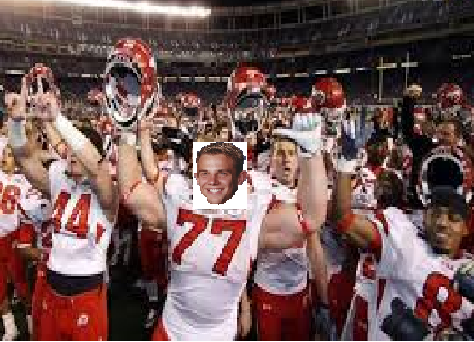
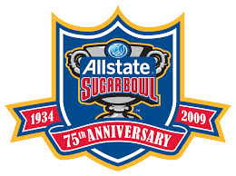
WE won the Game
In interesting element that goes into College Football is the Ownership the fans take in their teams as members of the institutions.

Slide 3
"Boston Game"
The game began to return to college campuses by the late 1860s.
Yale, Princeton, Rutgers, and Brown all began playing "kicking" games during this time.
In 1857, Princeton used rules based on those of the English Football Association.

Slide 4
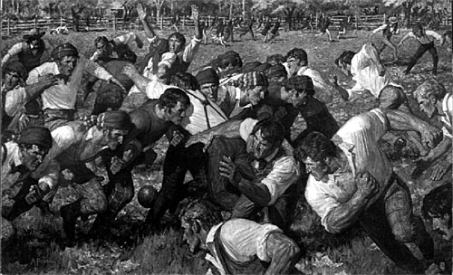
Rutgers v. Princeton (1869)
November 6, 1869- Rutgers University faced Princeton University in a game that was played with a round ball under "Football Association" rules but is regarded as the first game of intercollegiate football.
Two teams of 25 players attempted to score by kicking the ball into the opposing team's goal.
Throwing or carrying the ball was not allowed.
The first team to reach six goals was declared the winner.
By 1872 several schools were fielding intercollegiate teams, including Yale and Stevens Institute of Technology.

Slide 5
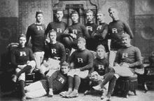
Rules standardization (1873–1880)
On October 20, 1873, representatives from Yale, Columbia, Princeton, and Rutgers met to codify the first set of intercollegiate football rules.
At this meeting, a list of rules, based more on soccer than on rugby, was drawn up for intercollegiate football games

Slide 6
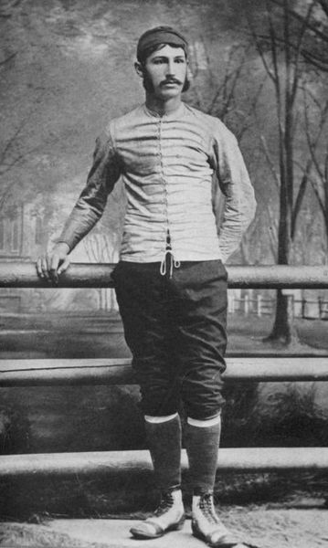
Walter Camp: Father of American football
Widely considered to be the most important figure in the development of American football
He proposed his first rule change in 1878:a reduction from fifteen players to eleven.

Slide 7
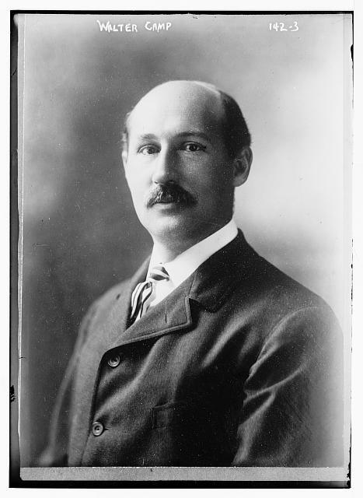
Walter Camp: Father of American football
Camp's most famous change, the establishment of the line of scrimmage and the snap from center to quarterback, was also passed in 1880.
Originally, the snap was executed with the foot of the center.
Changes made it possible to snap the ball with the hands, either through the air or by a direct hand-to-hand pass.

Slide 8
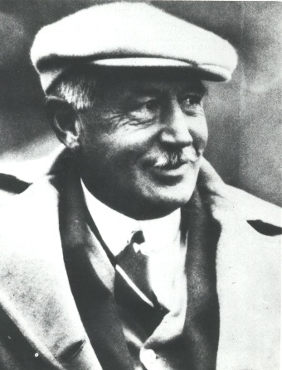
Walter Camp: Father of American football
1881- field was reduced in size to its modern dimensions of 120 by 53 1/3 yards
1883, four points for a touchdown, two points for kicks after touchdowns, two points for safeties, and five for field goals.
1887, game time was two halves of 45 minutes each.
1887, two paid officials for each game.
1888- allow tackling below the waist
1889- officials were given whistles and stopwatches

Slide 9
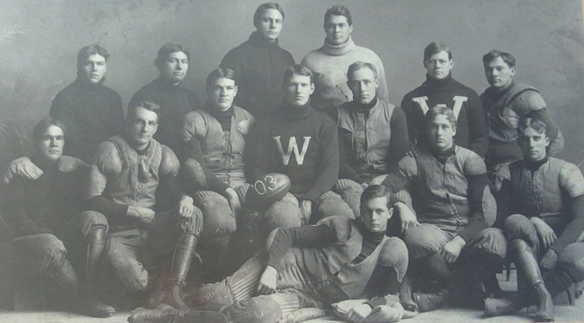
Expansion (1880–1904)
1880, only eight universities fielded intercollegiate teams
By 1900, the number had expanded to 43.
In 1879, the University of Michigan became the first school west of Pennsylvania to establish a college football team.
Led by legendary coach Fielding H. Yost, Michigan became the first "western" national power.
1901 to 1905- Michigan had a 56-game undefeated streak that included a 1902 trip to play in the first college football post-season game, the Rose Bowl.
During this streak, Michigan scored 2,831 points while allowing only 40

Slide 10
Violence and controversy (1905)
1894 Harvard-Yale game- known as the "Hampden Park Blood Bath", resulted in crippling injuries for four players
The annual Army-Navy game was suspended from 1894–1898
One of the problems was mass-formations like the flying wedge, in which a large number of offensive players charged as a unit against a similarly arranged defense. The resultant collisions often led to serious injuries and sometimes even death.
1905 there were 19 fatalities nationwide
President Theodore Roosevelt threatened to shut the game down if drastic changes were not made.
1906- devised to open up the game and reduce injury, was the introduction of the legal forward pass.

Slide 11
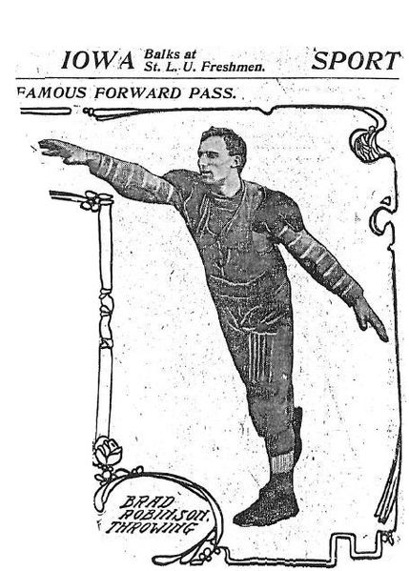
Modernization and innovation (1906–1930)
As a result of the 1905–1906 reforms,
mass formation plays illegal
forward passes legal.
Bradbury Robinson, at St. Louis University, threw the first legal pass in a September 5, 1906.
1910-
at least seven offensive players be on the line of scrimmage at the time of the snap,
no pushing or pulling, and that interlocking interference (arms linked or hands on belts and uniforms) was not allowed.
These changes greatly reduced the potential for collision injuries.

Slide 12
Modernization and innovation (1906–1930)
1914- the first roughing-the-passer penalty was implemented.
1918- the rules on eligible receivers were loosened to allow eligible players to catch the ball anywhere on the field—previously strict rules were in place only allowing passes to certain areas of the field.
Scoring rules changed:
field goals were lowered to three points in 1909
touchdowns raised to six points in 1912.

Slide 13
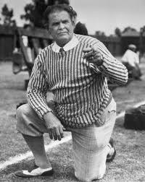
Glenn "Pop" Warner
Coached at :
University of Georgia, Cornell University, University of Pittsburgh, Stanford University, and the Temple University.
One of his most famous was at the Carlisle Indian Industrial School, where he coached Jim Thorpe
Wrote one of the first important books of football strategy, Football for Coaches and Players, published in 1927.
One of the first coaches to effectively utilize the forward pass.
Among his other innovations:
modern blocking schemes
Three-point stance
reverse play
The youth football league, Pop Warner Little Scholars, was named in his honor.

Slide 14
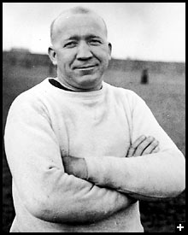
Knute Rockne
1913- an end for the University of Notre Dame.
Returned to coach the team in 1918, and devised the powerful Notre Dame Box offense, based on Warner's single wing.
Credited with:
being the first major coach to emphasize offense over defense.
Popularizing and perfecting the forward pass
It was during Rockne's tenure that the annual Notre Dame-University of Southern California rivalry began.
Led his team to an impressive 105–12–5 record before his premature death in a plane crash in 1931.

Slide 15
Great Rivalries
Army vs. Navy
Ohio State vs. Michigan
Alabama vs Auburn
USC vs Notre Dame
Oklahoma vs Texas
Miami vs. Florida State
Georgia vs. Florida
Cal vs Stanford
Utah vs. BYU

Slide 16
Bowl Games

Slide 17
Growth of bowl games 1930–2008^{[56]}
Year | # of games
1930 | 1
1940 | 5
1950 | 8
1960 | 8
1970 | 8
1980 | 15
1990 | 19
2000 | 25
2008 | 34

Slide 18
Bowl Championship Series
In 1998, a new system was put into place, the Bowl Championship Series.
For the first time, it included all major conferences (ACC, Big East, Big 12, Big Ten, Pac-10, and SEC) and all four major bowl games (Rose, Orange, Sugar and Fiesta).
The champions of these six conferences, along with two "at-large" selections, were invited to play in the four bowl games. Each year, one of the four bowl games served as a national championship game.
A complex system of human polls, computer rankings, and strength of schedule calculations was instituted to rank schools.
Based on this ranking system, the #1 and #2 teams met each year in the national championship game. Traditional tie-ins were maintained for schools and bowls not part of the national championship.
For example, in years when not a part of the national championship, the Rose Bowl still hosted the Big Ten and Pac-10 champions

