Slide 1
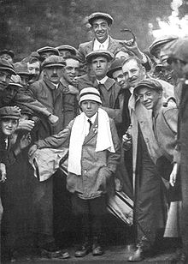
Golf

Slide 2
St. Andrews is often recognized as where the game was fostered.
It was responsible for 18 "holes" being the established norm for a full game, a standard adopted in 1764.

Slide 3
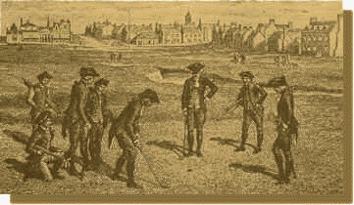
Gentleman's Game
At around 1650, golf was played in only about 12 locations in Scotland:
Domoch, Banff, and Aberdeen in the north;
Montrose, Carnoustie, Perth, St. Andrews and Leven further south
And at a few locations around the city of Edinburgh.
Played by Nobility and Gentlemen

Slide 4
In 1744 the Magistrates and Council of Edinburgh approved the first rules and regulations of golf, "Articles and Laws in Playing Golf - The Rules of The Gentlemen Golfers of Leith," as follows:
You must tee your ball within one club's length of the hole.
Your tee must be on the ground.
You are not to change the ball which you strike off the tee.
You are not to remove stones, bones or any break club for the sake of playing your ball, except on the fair green, and that only within a club's length of your ball.
If your ball comes among water, or any watery filth, you are at liberty to take out your ball and bringing it behind the hazard and teeing it, you may play it with any club and allow your adversary a stroke for so getting out your ball.
If your balls be found anywhere touching one another you are to lift the first ball till you play the last.
At holeing you are to play your ball honestly for the hole, and not to play upon your adversary's ball, not lying in your way to the hole.
If you should lose your ball, by its being taken up, or any other way, you are to go back to the spot where you struck last and drop another ball and allow your adversary a stroke for the misfortune.
No man at holeing his ball is to be allowed to mark his way to the hold with his club or anything else.
If a ball be stopp'd by any person, horse or dog, or anything else, the ball so stopp'd must be played where it lyes.
If you draw your club in order to strike and proceed so far in the stroke as to be bringing down your club; if then your club shall break in any way, it is to be accounted a stroke.
He who whose ball lyes farthest from the hole is obliged to play first.
Neither trench, ditch or made for the preservation of the links, nor the Scholar's Holes or the soldier's lines shall be accounted a hazard but the ball is to be taken out, teed and play'd with any iron club.

Slide 5
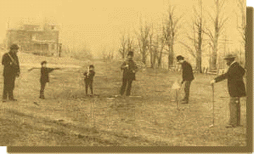
John Reid's cow pasture - one of the earliest golf courses in the United States

Slide 6
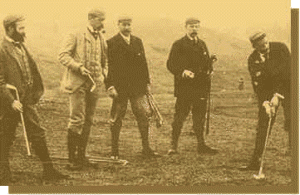
The First Amateur Championships in 1894. Charles Blair Macdonald is in the middle, third from left.

Slide 7
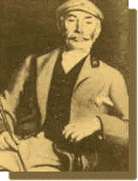
John Reid - The Father of American golf and helped make it an American Sport

Slide 8
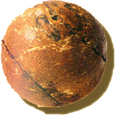
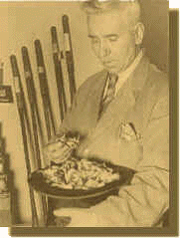
The first golf balls were made of wood until the early 17th century when the "feathery" came into use
The average player used four balls per round as the "feathery" had a tendency to split and get too damp
Each "feathery" was stuffed with more than a top-hatful of feathers

Slide 9
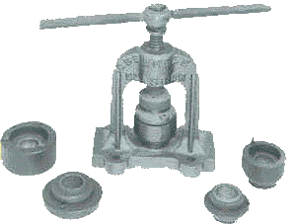
Golf balls made of gutta-percha were cheaper and more durable, helping dispel golf's image as a rich man's past-time.
This rudimentary implement was used to mound gutta-percha balls as of the late 19th century

Slide 10
The Haskell ball. It had a heart of tightly wound rubber and suddenly came into demand when Sandy Herd used one to win the 1902 British Open
The modern day balata ball. It generally was a water filled core wrapped in rubber yarn.

Slide 11
Typical golf clubs at the turn of the century.

Slide 12
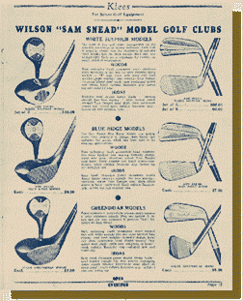
A golf club advertisement from the earlier part of the 20th century

Slide 13
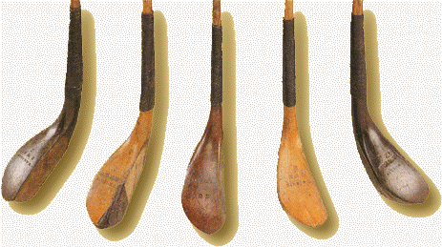
These clubs from the late 19th century are made out of beech wood.

Slide 14
Golf Terms
Albatross, Double Eagle = -3 in relation to par
Hole in 1, Eagle= -2 in relation to par
Birdie= -1 in relation to par
Par= Even the goal of golfers
Bogey= +1 in relation to Par
Double, Triple, Quadruple. . . Bogey

Slide 15
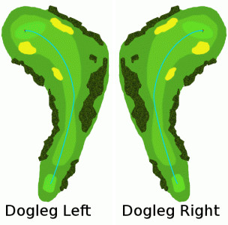
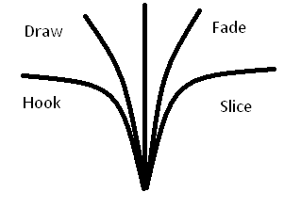
Golf Terms Continuted
Par 3,4,5
Dogleg
Hook, Draw, Fade, Slice

Slide 16
Men’s Major Championships:
In chronological order they are:
The Masters
U.S. Open
The Open Championship (referred to in North America as the British Open)
PGA Championship

Slide 17
Masters Tournament:
Scheduled for the first full week of April
Unlike the other major championships, the Masters is held each year at the same location, Augusta National Golf Club
A green jacket is awarded to the winner of each tournament

Slide 18
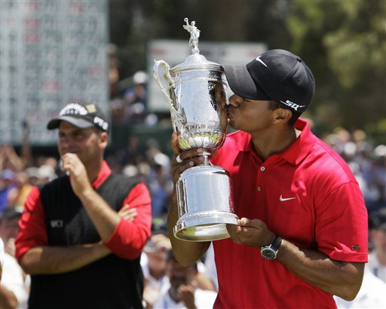
U.S. Open
Mid-June, scheduled so that, if there are no weather delays, the final round is played on the third Sunday, which is Father's Day.
Staged at a variety of courses
scoring is very difficult with a premium placed on accurate driving

Slide 19
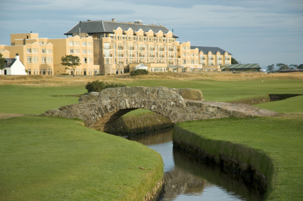
The British Open
The oldest of the four major championships
It is the only "major" held outside the USA
played on the weekend of the third Friday in July
takes place every year on one of nine links courses in Scotland or England

Slide 20
PGA Championship
Golf season's final major
played in mid-August (customarily four weeks after The Open Championship)
PGA champions are automatically:
Invited to play in the other three majors for the next five years
Are exempt from qualifying for the PGA Championship for life
Receive membership on the PGA and European Tours for the following five seasons
Invitations to The Players Championship for five years.

