Slide 1
Greatest Golfers
United States Sports History

Slide 2
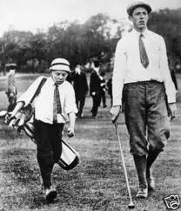
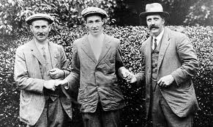
U.S.A. Accepts Golf
Francis Ouimet made American golf a legitimate sport in the United States.
Prior to Ouimet Golf was viewed as a European Sport
Won the 1913 U.S. Open

Slide 3
Players of the Decades
Decade Player PGA TOUR wins Majors 1920s Walter Hagen 31 8
1930s Gene Sarazen 22 3
1940s Ben Hogan 52 3
1950s Sam Snead 29 3
1960s Arnold Palmer 43 6
1970s Jack Nicklaus 38 8
1980s Tom Watson 19 5
1990s Nick Price 16 3
2000s Tiger Woods 56 12

Slide 4
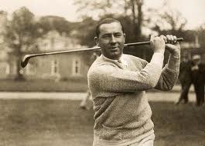
1910’s
Walter Hagen

Slide 5
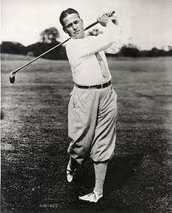
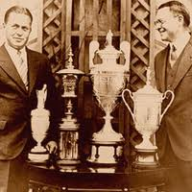
1920’s
Bobby Jones

Slide 6
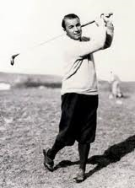
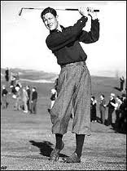
1930’s
Gene Sarazen
Bryon Nelson

Slide 7
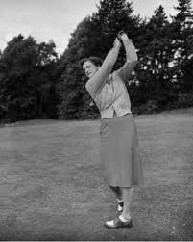
Worlds Greatest Women Athlete
Babe Zaharias

Slide 8
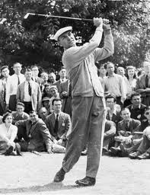
1940’s
Ben Hogan

Slide 9
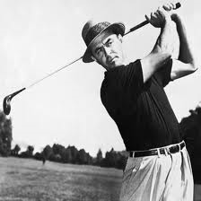
1950’s
Sam Snead

Slide 10
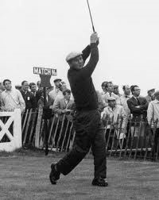
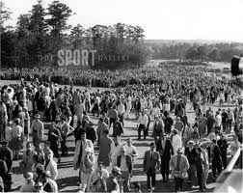
1960’s
Arnold Palmer

Slide 11
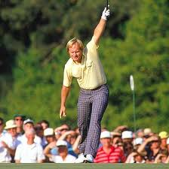
1970’s
Jack Nicklaus

Slide 12
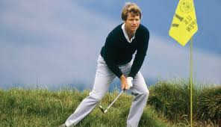
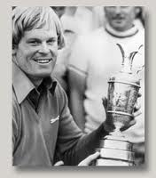
1980’s
Tom Watson
Johnny Miller

Slide 13
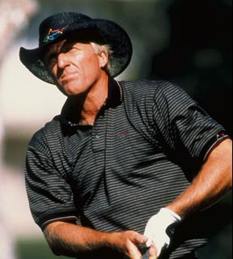
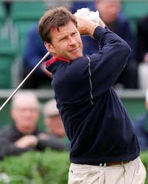
1990’s
Lull in American Talent

Slide 14
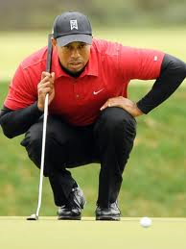
2000’s
Tiger Woods
Famous

Slide 15
2010
The Next Generation

