Slide 1
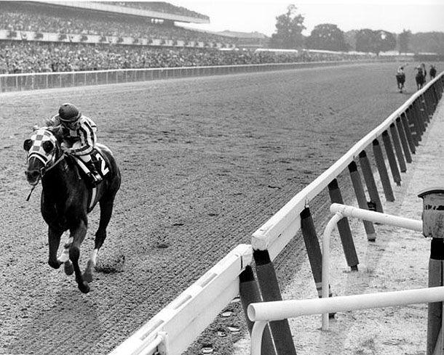
Horse Racing in the United States

Slide 2
Types of Horses in Horse Racing Thoroughbreds and Quarter Horses

Slide 3
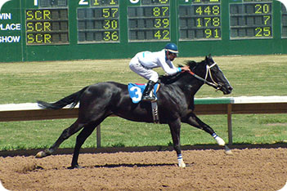
What are thoroughbreds?
The Thoroughbred is a horse breed best known for its use in horse racing. Although the word thoroughbred is sometimes used to refer to any breed of purebred horse, it technically refers only to the Thoroughbred breed.

Slide 4
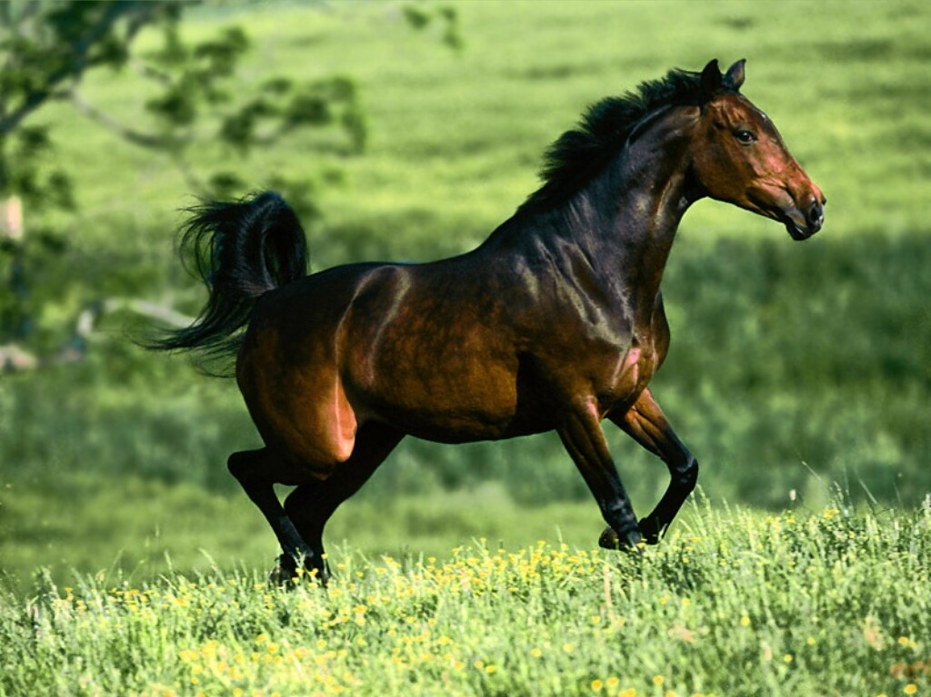
What are Quarter horses?
A Quarter horse is a small, stocky breed noted for agility and speed over short distances. It is reputed to be the fastest breed of horse over distances of a quarter of a mile.

Slide 5
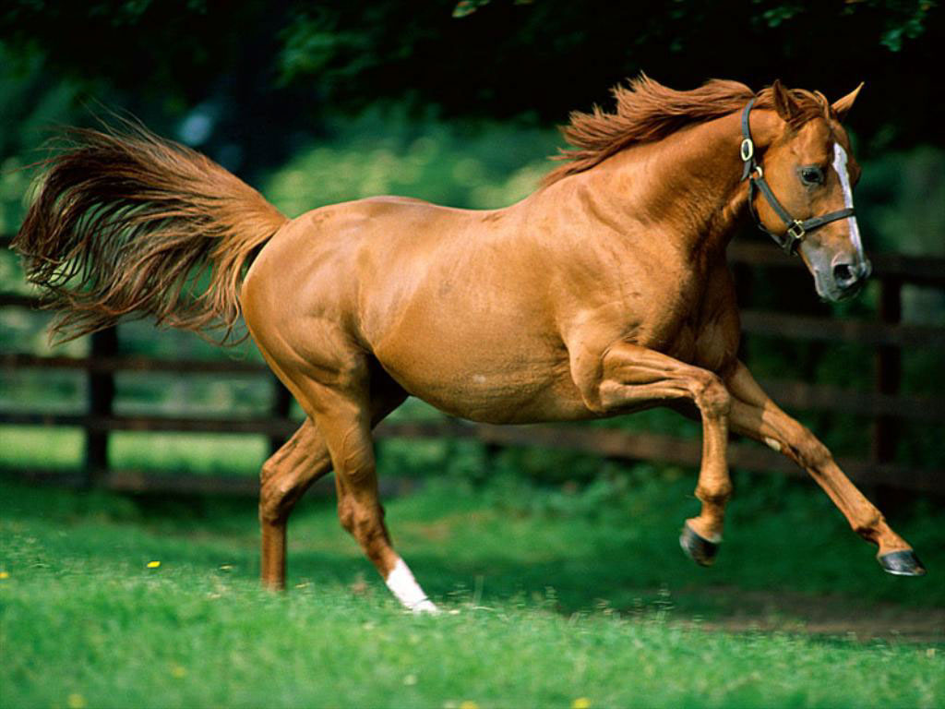
What is the difference?
The quarter horse is usually a few hands* shorter than Thoroughbreds.
Also the quarter horse is usually stockier and more muscular than thoroughbreds.
But thoroughbreds usually have longer and thinner legs and bodies.
*(standard unit of measurement for horses; each hand is four inches)

Slide 6
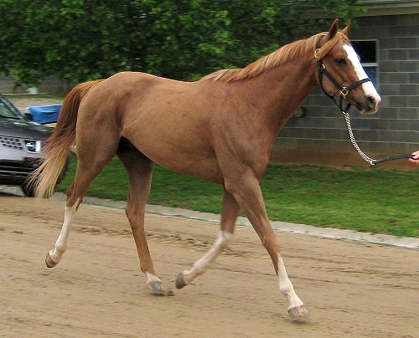
Compare
Quarter Horse
Thoroughbred Horse

Slide 7
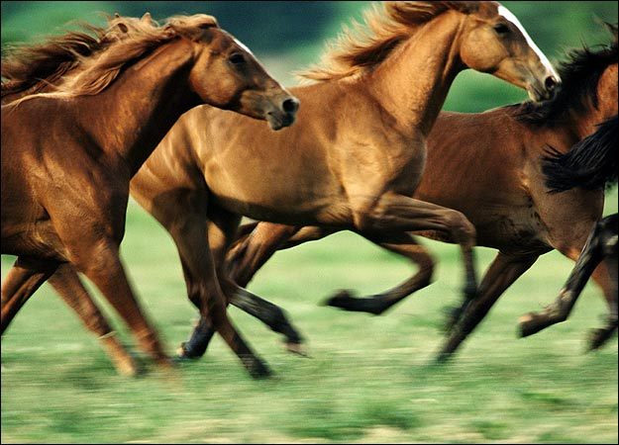
How are they raced
Quarter Horses are best at short sprints like the Quarter Mile hence the name Quarter Horse.
Thoroughbreds are usually raced in long distance endurance races.

Slide 8
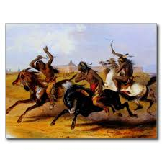
Early History in America
Racing Horses has existed from the beginning of sport.
Sioux Indians Racing Horses

Slide 9
Horseracing's Popularity
From the mid 1600’s up until the Civil War(1865) Horseracing was the most popular sport in America. Which makes it the most popular sport in United States History!!!?

Slide 10
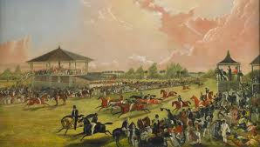
Horse Racing in the Colonies
Modern Horse Racing was first introduced by the British in the 1660’s in the United States as a rich white mans sport.

Slide 11
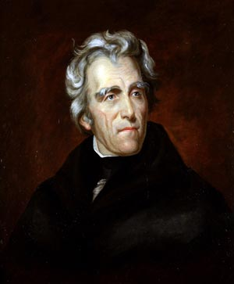
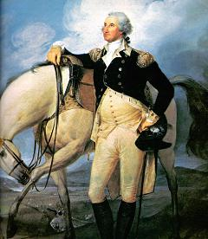
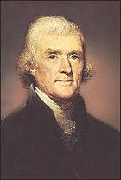
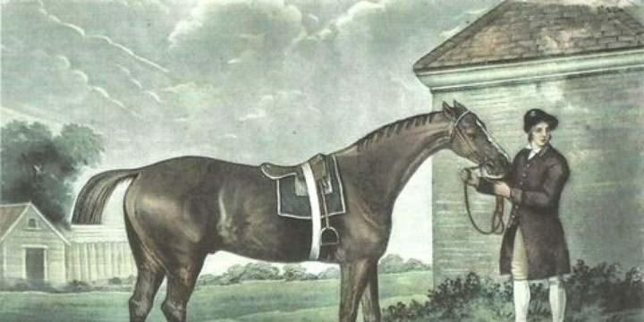
Horse Racing and the Presidents
No sport created more excitement, enthusiasm and interest in the colonial period and the early republic than horse racing. Presidents George Washington and Thomas Jefferson took immense pride in their horses and bred them to improve the bloodlines of saddle, work, carriage and racehorses. Early presidents loved horse racing, the most popular sport in America at that time. George Washington, considered by his peers as the best horseman of his era, helped organize races in Alexandria, Virginia, and frequently attended race meetings throughout the region. Jefferson rarely missed the meets at the National Race Course in Washington, D.C., which opened just outside the city boundary two miles north of the White House in 1802. The best horses in the country competed there into the 1840s, and the Jockey Club dinner and ball, a highlight of the social season, concluded the meeting. Andrew Jackson’s passion for horse racing and gambling was renowned and he once fought a duel over an argument sparked by a wager. Jackson bred racehorses at the Hermitage and operated a racing stable from the White House during his presidency. It was an open secret that Jackson entered runners in the name of his nephew and private secretary Andrew J. Donelson.

Slide 12
Horseracing's Popularity
Arguments against this fact that horseracing is the most popular sport in United States History are. . .
Prior to the 1850’s America had no popular culture, only localized traditions and sports.
Arguments could be make that boxing was more popular as a poor mans sport and horseracing as a rich man’s sport
Also, modern sports like baseball, football, and basketball where yet to be invented. So choices were limited.
Also. . .

Slide 13
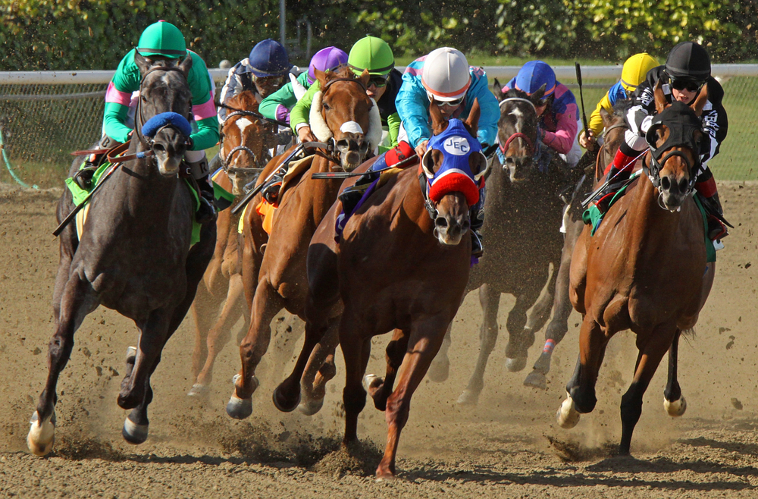
Horse Racing and Progressive Era
Organized professional racing didn’t exist in America until after the Civil War in 1865.
By 1890 there were 314 operation tracks in America.

Slide 14
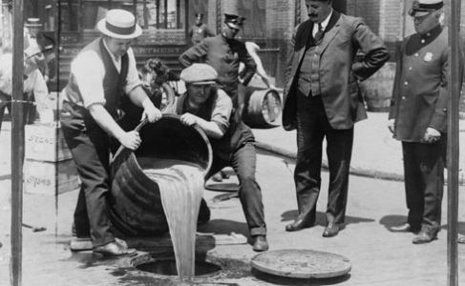
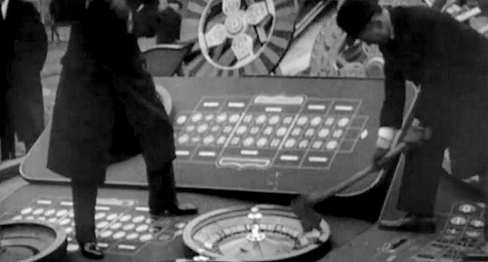
In the early 1900’s horse racing was almost wiped out due to WWI, antigambling, temperance and progressive movements
By 1908 only 25 tracks remained.

Slide 15
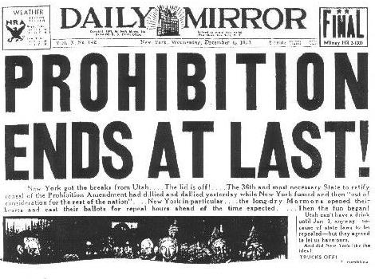
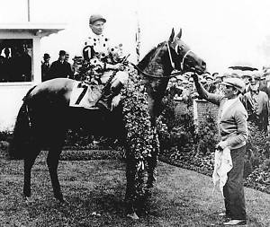
Golden Age of Horse Racing 1930-1950
With the end of Prohibition can the end of anti gambling laws as well. This law change will usher in a golden age of American Horse Racing

Slide 16
Horse Racing During the Great Depression
People watched Horse racing to create Diversion while they were struggling during the Great Depression. The beauty and excitement of racing drew many fans to the stands. This sport gave relief from the tight clamp of poverty for a short period of time while spectators watched.

Slide 17
Horse Racing During the Great Depression
Horse racing was one of the only places to bet. “The opportunities for gambling in the 1930s were very limited,” There were no state lotteries. Football was a very minor sport.... There were casinos in Nevada, but how many people go to Nevada? Hence the only place you could really bet was at a racetrack.” –Gene Smith
A $100,000 winner-takes-all prize in most racing bets drew horses, and the horses drew fans during the economically sour times.

Slide 18
During the Great Depression
Horse racing was very popular during the Depression. Seabiscuit was a sports celebrity, a day at the races offered affordable entertainment (if you watched your gambling), with low general admittance prices for the grandstand area and increasing prices for clubhouse and turf club admittance. People went out and did things before there was television and computers and all the things that make our homes so comfortable and satisfying to be in these days; but in those days, there was radio, newpapers, magazines, movies and sporting events, and horse racing enjoyed the same kind of popularity as baseball or boxing matches or Saturday afternoon at the movies.

Slide 19
During the Great Depression
People visited the track by the thousands every day, eager for the drama of a horse race. Horse racing, along with baseball, dominated the sports world. Sports were not the only diversions available to Americans struggling to grind out a living

Slide 20
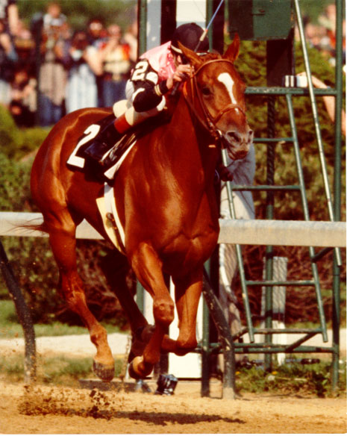
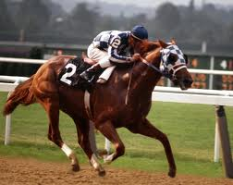
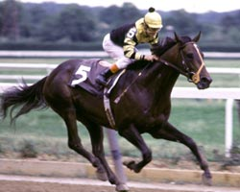
Horse Racing Resurges
Secretariat
Seattle Slew
Affirmed
1977
1973
1978

Slide 21
Gambling on Horses
Approximately 13 billion dollars are bet every year on horseracing
Bets are based on odds determined by amount of people making the bets.

Slide 22
Triple Crown
The Triple Crown is a series of three Thoroughbred horse races for three-year-old horses run in May and early June of each year consisting of the Kentucky Derby, Preakness Stakes, and Belmont Stake.

Slide 23
First Winner
Sir Barton was the first Triple Crown winner in 1919.
Sir Barton was the grandson of 1893 English Triple Crown winner Isinglass, Sir Barton was a most unlikely thoroughbred to become the first to win the Kentucky Derby, the Preakness and the Belmont. Sir Barton was entered in the 1919 Kentucky Derby to set the pace for his more famous stable mate, Billy Kelly, but he ended up winning the Run for the Roses by five lengths.

Slide 24
Sir Barton

Slide 25
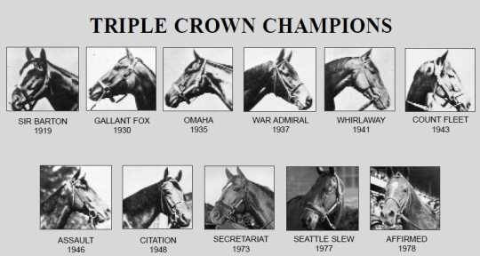
The Winners
There have been 11 Triple Crown winners.
Thirty horses have won the first two legs of the Triple Crown, but 19 of them failed to win the Belmont. In addition to Sir Barton, the other Triple Crown winners have been

Slide 26
Races
On five occasions, betting on the Belmont Stakes was as easy as flipping a coin.
While a field of 12 raced in the 2012 Belmont, there were five times when the race had only two horses in the field: 1887, 1888, 1892, 1910 and 1920.

Slide 28
The Drought
It has been 34 years since the last Triple Crown winner.
No horse has won the Triple Crown since Affirmed nosed out Alydar at the finish line of the 1978 Belmont. It marks the longest drought since Sir Barton won the first Triple Crown. There have been plenty of near misses over the last 34 years,
Since 1978, 12 horses have won the Kentucky Derby and the Preakness but not the Belmont.

Slide 29
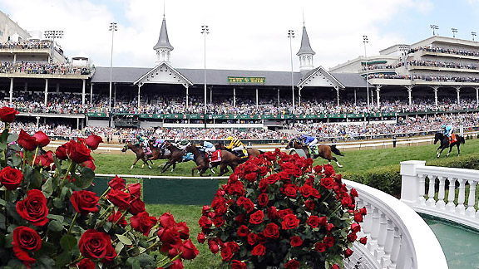
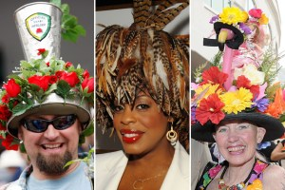
Kentucky Derby
Run for the Roses
The most exciting 2 minutes in sports
First Saturday in May
Churchill Downs, Louisville, Kentucky
3 year old Thoroughbreds
1 ¼ miles long
164,858 in attendance for the 2013 Derby
First Leg in the Triple Crown
Record 1:59 2/5 secs
by Secretariat

Slide 30
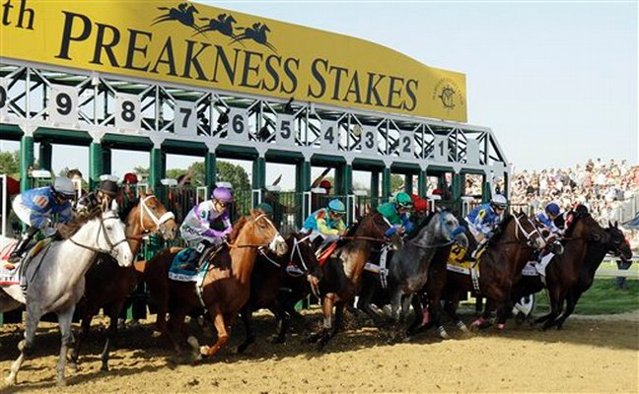
Preakness Stakes
The Run for the Black-Eyed Susans
Third Saturday in May
Pimlico Race Course, Baltimore, Maryland
3 year old Thoroughbreds
1 3/16 miles long
Second Leg in the Triple Crown
Record 1:53.00
Secretariat

Slide 31
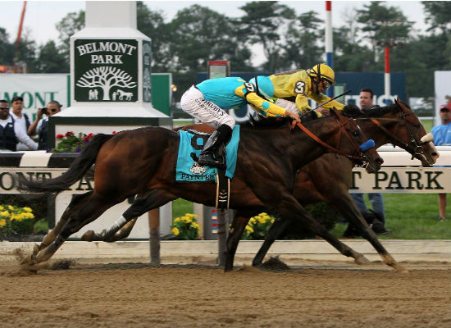
Belmont Stakes
Test of Champions
First Saturday in May
Belmont Park, Elmont, New York
3 year old Thoroughbreds
1 1/2 miles long
Third Leg in
the Triple Crown
Record 2:24
Secretariat

Slide 32
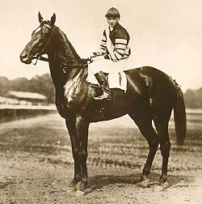
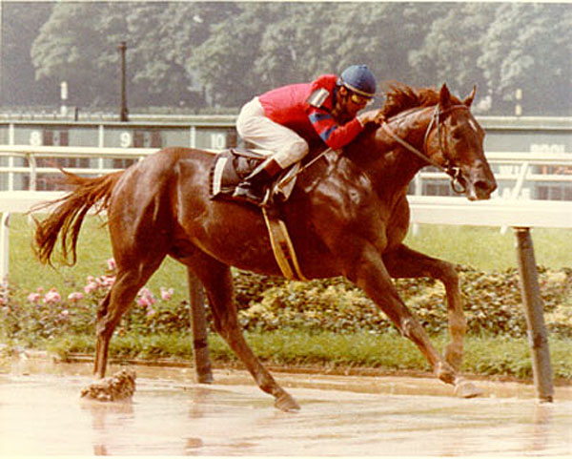
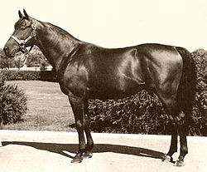
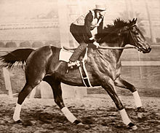
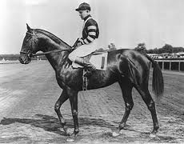
Famous Horses Hoof-Hearted

Slide 33
Man o’ War
21: 20–1–0
Credited for rescuing American horse racing in the 1920s.
Man O' War had a reputation of being a "sure thing" in betting circles.
He was such a “sure thing” that even other owners of horses were wary of betting for their
own horse.
He only lost one race his entire
career. The race he lost, he started
backward at the starting line, and
still finished second.

Slide 34
War Admiral
26: 21-3-1
He was the son of Man o’ War.
In 1939, he won Horse of the Year, as well as the Triple Crown.
In 1958, he was inducted into the National Museum of Racing and Hall of Fame.

Slide 35
Seabiscuit
89: 33-15-1
Was not very successful until 1936 when he got a new trainer and jockey.
After 1936, Seabiscuit’s popularity soared when he won 11 of 15 races he entered.
Seabiscuit’s rise in popularity caused spirits to rise among the American people during the great depression.
His race against War Admiral in 1939 is known as the “Match of the Century.”
His victory also raised spirits when he beat War Admiral

Slide 36
Citation
45: 32-10-2
Citation won his first race in 1947 at Havre de Grace.
Citation won the Triple Crown in 1948.
Some racing fans think of him as good, if not better than Man o’ War.
He was the first race horse to ever win one million dollars.

Slide 37
Secretariat
21:16-3-1
Many thought he was too “good looking” to be a good race horse.
He proved this wrong when he was the first two-year-old horse to be named “Horse of the Year.”
In 1973 he won the Triple Crown.
Secretariat also won the Belmont Stakes and set the world record which still stands today.

Slide 38
Affirmed
29: 22-5-1
Affirmed is known as one of the most lucrative race horses of his time.
During his career, he was the first horse to bring in over two million dollars.
The main highlight of his career was in 1978, he won the Triple Crown.

Slide 39
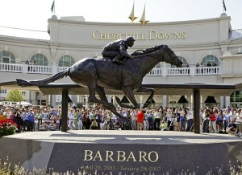
Horse Racing Today
Horse racing is at a lull in popularity, mostly because it has been 36 years since a triple crown winner has emerged.
Also adding to the lack of popularity is more information about treatment of horses and animal rights activists like PETA protesting at the sporting events.
Horse Racing today is relevant for about 2 minutes every year and is mostly a red carpet event for the wealthy to get twitter followers
However. . . All it will take is one thoroughbred to capture the heart of the nation and win the triple crown.

