Slide 1
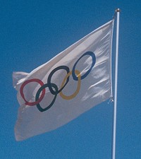
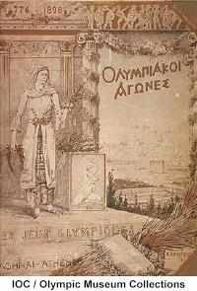
The Olympic Games
Ancient Games and the
Modern Games

Slide 2
The Ancient Olympics
Began in 776 BC at Olympia, Greece
Originally a religious ceremony in honor of the Greek gods.
100 oxen were sacrificed at the beginning of the Games
“Olympic Truce:” All wars and battles were halted so that everyone could come and watch the Games.
Based on 4-year periods called Olympiads

Slide 3
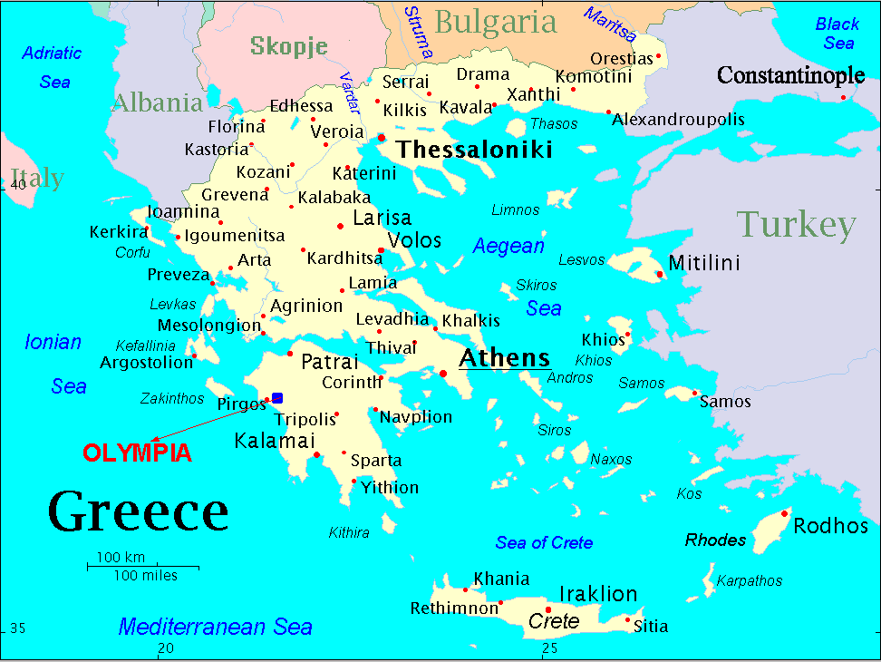

Slide 4
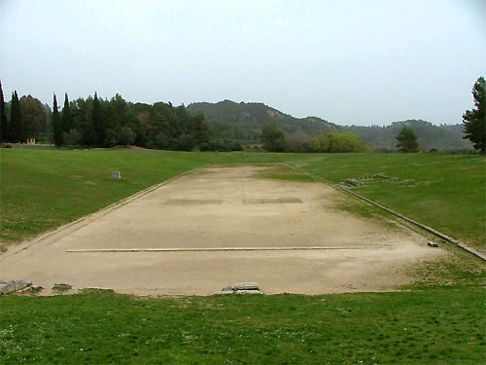
Original Running Track: Olympia, Greece

Slide 5
The Olympic Athlete
Men only allowed to play
Men had to play in the nude or with very little clothing (“gymnos”)
Running was the only event at the first Games

Slide 6
Important Olympic U.S. Moments Events and People
World wide
U.S. Society
Greatest Moments
Greatest Athletes
Future Olympics

Slide 7
World Wide Olympics

Slide 8
Triumph through Struggle
Dorando Pietri at the Marathon finish Olympic Games 1908 London
Awarded a Gold Cup by Queen Alexandria for his efforts
Considered my Historians to be the “Race of the Century”

Slide 9
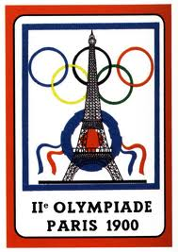
Paris Games in 1900
Women first allowed to Participate
At the first modern Olympic Games in Athens 1896, no women competed, as de Coubertin felt that their inclusion would be "impractical, uninteresting, unaesthetic, and incorrect."
Women first competed at the 1900 Paris Games. Women were allowed to compete in lawn tennis and golf, though there were three French women competing in croquet and there was at least one woman sailor as part of mixed crews. It is commonly believed that first woman to win an Olympic event was England's Charlotte Cooper, who won the tennis singles title, however Swiss sailor Hélène de Pourtalès won a gold medal as part of a team in sailing earlier than this.

Slide 10
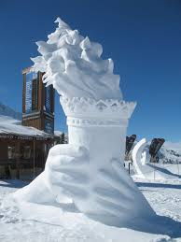
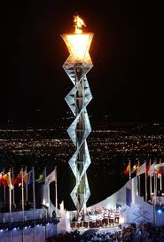
Winter Olympics
First Winter Olympics were in 1924 in France
Summer and Winter games were held every year until 1992/94 in Lillehammer, Norway, when the games split into the current 2 year schedule

Slide 11
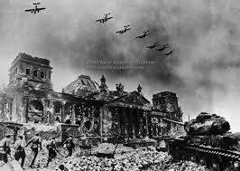
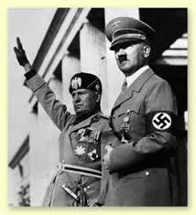
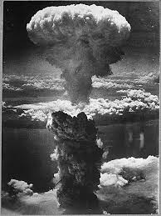
Canceled Olympic Games
1916 Berlin Games
1940 Tokyo Games
1944 London Games
1948 London Games*

Slide 12
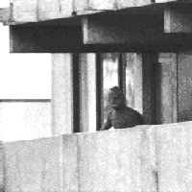
Munich, 1972
Terrorists took several Israeli athletes hostage
They were killed as they were being rescued

Slide 13
American Boycotts
1980 Moscow Games
Due to Soviet Invasion of Afghanistan
1984 Los Angles Games
14 countries boycott due to America boycott of Munich Games

Slide 14
Barcelona 1992 Games
First Games after the Fall of the Soviet Union
Many E. European countries competed separate from Soviet Block
East and West Germany competed together for the first time since 1936

Slide 15
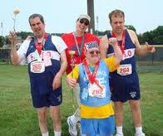
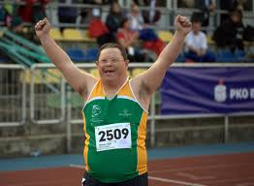
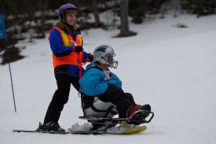
Special Olympics
1968 First Games in Chicago
1988 officially recognized by the IOC
2003 first games outside of the U.S. in Dublin Ireland
4.2 Million Athletes in 170 counties
2011 Summer games in Athens
2013 Winter Games in Korea

Slide 16
Important American Social Moments
Summer Host Cities
1904 St. Louis, MO (Chicago)
1932 Los Angles, CA
1984 Los Angles, CA
1996 Atlanta, GA
Winter Host Cities
1932 Lake Placid, NY
1960 Squaw Valley, CA
1980 Lake Placid, NY
2002 Salt Lake City, UT

Slide 17
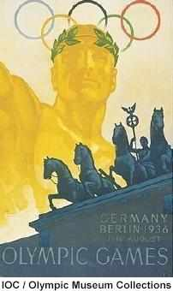
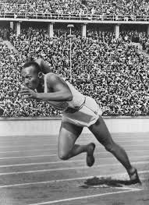
Berlin, 1936
Hosted by the Nazis
Germans believe they were the best athletes in the world
Jessie Owens, a Black American runner, won four medals and shattered that myth

Slide 18
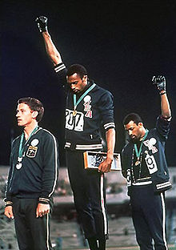
1968 Mexico City Games
Tommie Smith and John Carlos
Shoeless- black poverty
Black scarf- Black pride
Unzipped jacket- blue collar workers
Black Power Salute- during nation anthem

Slide 19
1972 Munich Games
Men’s Basketball
Basketball was introduced in 1936 and the United States had never lost. In the midst of the Cold War the United States were beat by the Soviet Union.
The U.S. took silver. . .. the medals were never claimed

Slide 20
Lake Placid, NY 1980
“Miracle on Ice”

Slide 21
1992 Barcelona Games
“The Dream Team”
For the first time in Olympic History Professional Athletes were allowed to participate in Olympic Sports due to an IOC rules change in 1988

Slide 22
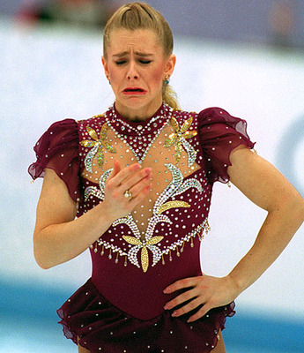
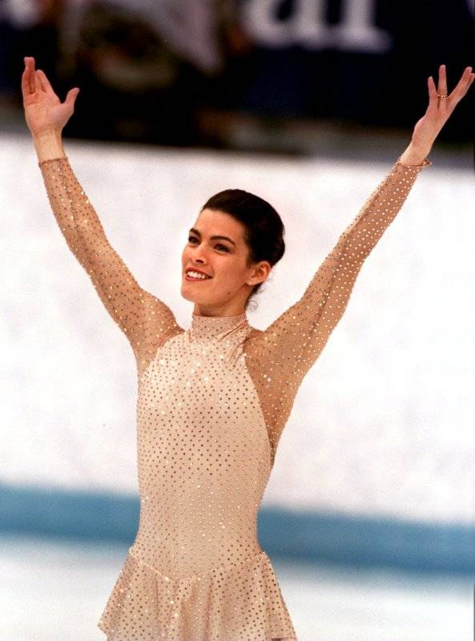
Lillehammer, 1994
Nancy Kerrigan
Tonya Harding

Slide 23
Atlanta, 1996
Centennial of the Games
Many thought it would go to Athens, Greece
10,000+ athletes took part
Bomb exploded in Centennial Park

Slide 24
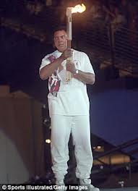
Greatest Moments/Athletes
Ali Lights the Torch Atlanta 1996

Slide 25
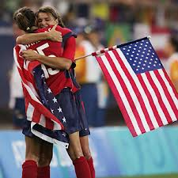
Greatest Moments/Athletes
2004 Women’ Soccer Takes Gold
Is there anything more exhilarating than winning a professional sports championship in overtime, with a game-winning score? Well, how about a gold medal-winning overtime goal? This is precisely what the U.S. Women’s Soccer Team accomplished in the 2004 Athens Games, when Abby Wambach scored the winning goal against Brazil in overtime – earning the team their second gold medal in eight years. And for those who are wondering, this was not the women's soccer victory in which defender/midfielder Brandi Chastain took off her jersey to expose her sports bra (that would be the 1999 Women's World Cup) . . .

Slide 26
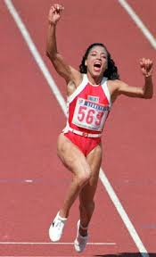
Greatest Moments/Athletes
1998
Florence Griffith Joyner
Florence Griffith-Joyner (also known as Flo-Jo) won three gold medals in the track and field competition at the 1988 Seoul Olympics, in the 100 meters, 200 meters and 4x100 meters relay competitions, resulting in Flo-Jo being christened "the fastest woman of all time." Despite rumors of steroid use, Griffith-Joyner was tested during the competition and did not fail any drug tests. Sadly, Griffith-Joyner would die at the age of 38 in 1998, due to suffocation during an epileptic seizure.

Slide 27
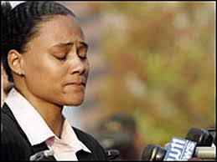
Greatest Moments/Athletes
Marion Jones
2000 Sydney Games
3 Gold Medals
2007 Prison for 6 months for lying to Federal Judge as part of the BALCO steroid investigation

Slide 28
Greatest Moments/Athletes
Bonnie Blair
6 Golds Medals
From 1984 to 1994
Most Decorated Winter Olympian

Slide 29
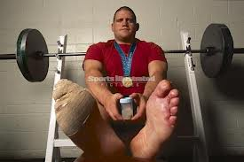
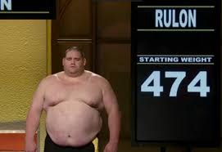
Greatest Moments/Athletes
Rulon Gardner vs. Alexander Krulin Sydney 2000

Slide 30
Greatest Moments/Athletes
1984
Mary Lou Retton
First American Women to win Women's Gymnastics all around title

Slide 31
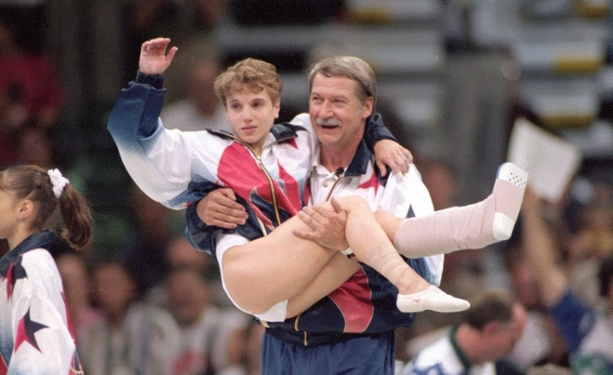
Greatest Moments/ Athletes
Atlanta 1996
Women’s Gymnastics Team
Kerri Strug on the vault

Slide 32
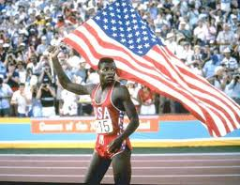
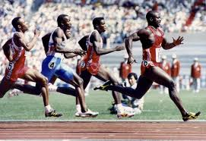
Greatest Moments/Athletes
Why not think big? That's a sentiment that runner Carl Lewis used for inspiration going into the 1984 Los Angeles Games, when he sought to match the high mark set by the great Jesse Owens at the 1936 Berlin Olympics, who netted a total of four gold medals. Lewis did indeed manage to accomplish this goal, taking the gold in the following categories – 100m, 200m, 4x100m relay and long jump. Lewis would go on to further success in subsequent Olympic games, earning two gold medals in 1988, two more in 1992, plus another one in 1996 – resulting in a total of nine gold medals during his Olympic career

Slide 33
Greatest Moments/Athletes
Bob Beamon 1968
Set a new WR in Long Jump by jumping 29 ft. 2.5 in. beating the old record of 27 ft. 4 in. by 22.5 inches

Slide 34
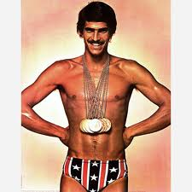
Greatest Moments/Athletes
Mark Spitz
1972 Munich Games
7 Gold Medals

Slide 35
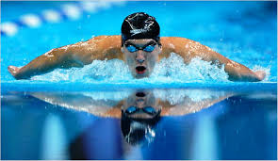
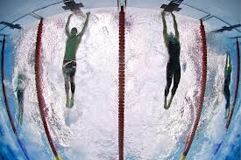
Greatest Moments/Athletes
Michael Phelps
2004 6 Gold 2 Bronze
2008 8 Gold 7 WR
2012 4 Gold 2 Silver
39 WR (7 Currents)
Most decorated athlete in History

Slide 36
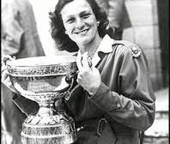
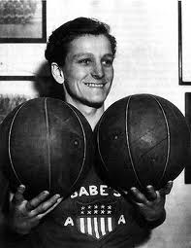
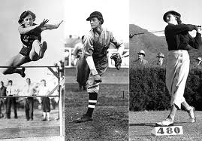
Greatest Moments/ Athletes
Babe Didrikson
Zaharias
In the 1920s and 30s women just weren't athletes. Oh sure, they could have been, but the idea of a muscular woman running, jumping, and competing like her male counterparts was so frowned upon that they were almost deemed freakish.
Mildred (Babe) Didrikson Zaharias didn't care. For the 5-foot-5 Beaumont, Texas native, athletics was her life. Name a sport and Babe was good at it. She was once asked if there was anything she didn't play, and she quickly replied, "Yeah, dolls."
Baseball? Well her nickname was "Babe," wasn't it? She was supposedly given the name due to her Ruth-like, tape-measure home runs as a teenager.
Golf? She won 13 consecutive tournaments as an amateur, then became one of the best LPGA players of all time, winning 31 tournaments, three of them U.S. Opens.
Track and field is where she earned her Olympic glory. At the AAU Championships in 1932, which also served as the Olympic trials for the '32 games in Los Angeles, Babe not only qualified but single-handedly won the meet for her team, Employers Casual Company. There were ten events in the competition. Babe participated in eight of them—and won six! She won the shot put and long jump, and broke the world record in the javelin, the baseball throw, the 80-meter hurdles, and the high jump. Her overall point total amounted to 30, eight more than the entire 22-woman University of Illinois team.
At the age of 21, Babe competed in three events at the 1932 Olympics—the 80-meter hurdles, the javelin, and the high jump. She would have competed in more, but at the time women were limited to competing in up to three individual events. She easily won the javelin, the first Olympic javelin event ever available to women, with a hurl of 143 feet, four inches. Then she broke the world record in the first women's Olympic 80-meter hurdles with a time of 11.7 seconds.
She actually tied for the gold in the high jump with Jean Shiley, but was only awarded the silver after it was determined that her jumping style was illegal. Always ahead of her time, Babe's head crossed the bar before her body, much like the "Fosbury Flop" that is the popular style today.
In spite of her amazing success (and sometimes because of it), Babe had plenty of critics who claimed she should act and dress less manly. Eventually she did soften those critics by growing her hair out, wearing long dresses and marrying, but she never changed who she really was. When she was asked how in the world a woman could possibly drive a golf ball 250 yards down the fairway, Babe explained, "You've got to loosen your girdle and let it rip."

Slide 37
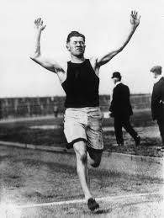
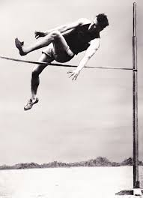
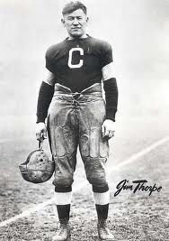
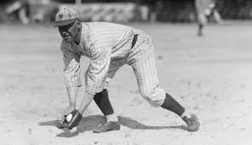
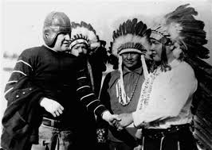
Greatest Moments/Athletes
Jim Thorpe Greatest Athlete Ever
1912 Olympics Decathlon and Pentathlon Champion

Slide 38
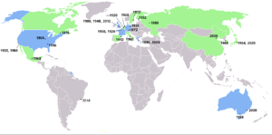
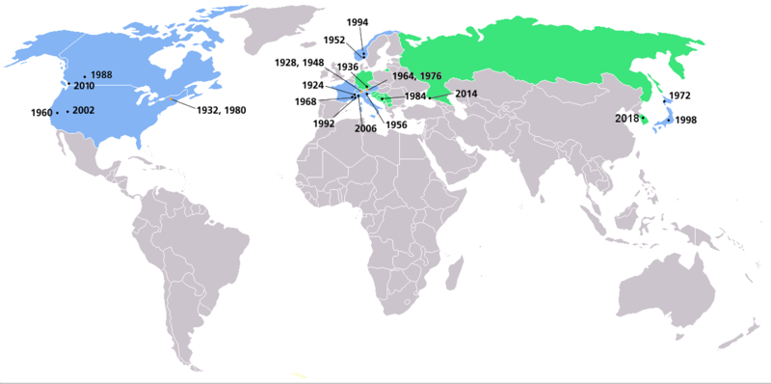
Future Olympic Cities
Summer 2016-
Rio de Janeiro, Brazil
Winter 2018-
PyeongChang, S. Korea
Summer 2020-
Istanbul, Turkey
Tokyo, Japan
Madrid, Spain

