Slide 1
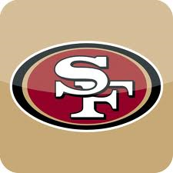
Professional Football

Slide 2
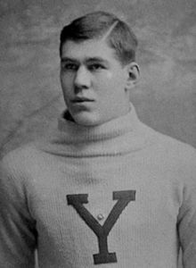
Early players, teams, and leagues (1892–1919)
In the early 20th century, football was the subject of intense competition and rivalry, albeit of a localized nature.
The Allegheny Athletic Association hired former Yale All-American guard William "Pudge" Heffelfinger.
November 12, 1892, Heffelfinger became the first known professional football player. (Secret)
He was paid $500 to play in a game against the Pittsburgh Athletic Club.
Heffelfinger picked up a Pittsburgh fumble and ran 35 yards for a touchdown, winning the game 4–0 for Allegheny.

Slide 3
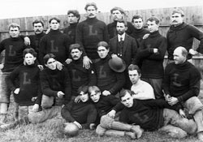
Early players, teams, and leagues (1892–1919)
On September 3, 1895 the first wholly professional game was played, in Latrobe, Pennsylvania, between the Latrobe Athletic Association and the Jeannette Athletic Club.
In 1897, the Latrobe Athletic Association paid all of its players for the whole season, becoming the first fully professional football team.
In 1898, William Chase Temple took over the team payments for the Duquesne Country and Athletic Club, a becoming the first known individual football club owner.
1899, the Morgan Athletic Club, on the South Side of Chicago, was founded.
This team later became the Chicago Cardinals, and now is known as the Arizona Cardinals, making them the oldest continuously operating professional football team

Slide 4
Early players, teams, and leagues (1892–1919)
The first professional football league was the National Football League (not the same as the modern league) began play in 1902.
The Pirates' team the Pittsburgh Stars were awarded the league championship. However the Philadelphia Football Athletics and Philadelphia Football Phillies also claimed the title.
A five-team tournament, known as the World Series of Football was organized by Tom O'Rouke, the manager of Madison Square Garden.
The event featured the first-ever indoor pro football games.
The very first professional indoor game came on December 29, 1902
The World Series only lasted two seasons.

Slide 5
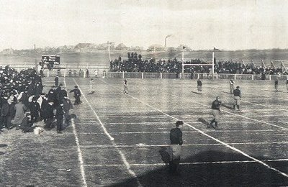
Early players, teams, and leagues (1892–1919)
The game moved into Ohio which became the center of professional football during the early decades of the 20th century.
Small towns such as Massillon, Akron, Portsmouth, and Canton all had professional teams known as the "Ohio League," the direct predecessor to today's National Football League.
In 1906 the Canton Bulldogs–Massillon Tigers betting scandal became the first major scandal in professional football.
In 1915, the reformed Canton Bulldogs signed former Olympian and Carlisle Indian School standout Jim Thorpe to a contract. Thorpe became the face of professional football for the next several years and was present at the founding of the National Football League five years later.

Slide 6
Early years of the NFL
(1920–1945)

Slide 7
Formation
In 1920, the American Professional Football Association was founded in Canton, Ohio. Jim Thorpe was elected the league's first president.
The original teams were:
Akron Pros
Buffalo All-Americans
Canton Bulldogs
Chicago Tigers
Cleveland Indians
Columbus Panhandles
Dayton Triangles
Decatur Staleys
Detroit Heralds
Hammond Pros
Muncie Flyers
Racine Cardinals
Rochester Jeffersons
Rock Island Independents
In its early years the league was a formal agreement between teams to play each other and to declare a champion at season's end.
Teams were still permitted to play non-league members.

Slide 8
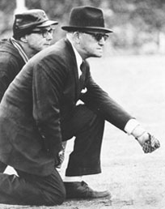
Expansion
In 1921, more teams joined the league, increasing the membership to 22 teams.
Green Bay Packers: has the record for longest use of an unchanged team name
1921, A. E. Staley, the owner of the Decatur Staleys, sold the team to player-coach George Halas.
1921, Halas moved the team to Chicago
1922 renamed the Chicago Bears.

Slide 9
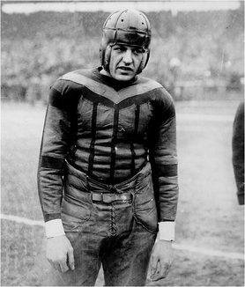
Expansion
By the mid-1920s, NFL membership had grown to 25 teams
Several college stars joined the NFL, most notably Red Grange from the University of Illinois
A scandal involved a Chicago player, Art Folz, hiring a group of high school football players to play for the Milwaukee Badgers, against the Cardinals

Slide 10
1932 NFL playoff game
At the end of the 1932 season, the Chicago Bears and the Portsmouth Spartans were tied
Chicago won, 9–0.
The playoff was so popular that the league reorganized into two divisions for the 1933 season, with the winners advancing to a scheduled championship game.
A number of new rule changes were also instituted:
the goal posts were moved forward to the goal line
every play started from between the hash marks,’
forward passes could originate from anywhere behind the line of scrimmage
In 1936, first draft of college players.
The first selection was Heisman Trophy winner Jay Berwanger

Slide 11
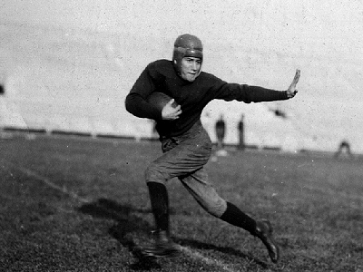
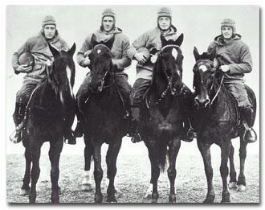
War Years
In 1941, the NFL named its first Commissioner, Elmer Layden.
During World War II, a player shortage led to a shrinking of the league as several teams folded and others merged.

Slide 12
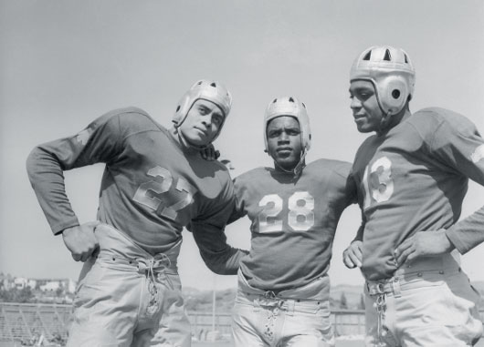
Stability and growth of the NFL (1946–1957)
1946, the NFL had ten teams, nine of which are still in operation today.
The league integrated in 1946, when the Los Angeles Rams signed two African American players, Kenny Washington and Woody Strode.
1946, a competing league, the All-America Football Conference (AAFC), began operation.

Slide 13
Stability and growth of the NFL (1946–1957)
1950, the AAFC folded, and three teams from that league were absorbed into the NFL:
Cleveland Browns (who had won the AAFC Championship every year of the league's existence)
San Francisco 49ers
Baltimore Colts
The remaining players were chosen by the now 13 NFL teams in a dispersal draft.
1950, the Los Angeles Rams became the first team to televise its entire schedule
The players' union, known as the NFL Players Association, formed in 1956

Slide 14
NFL supremacy
(1958–present)

Slide 15
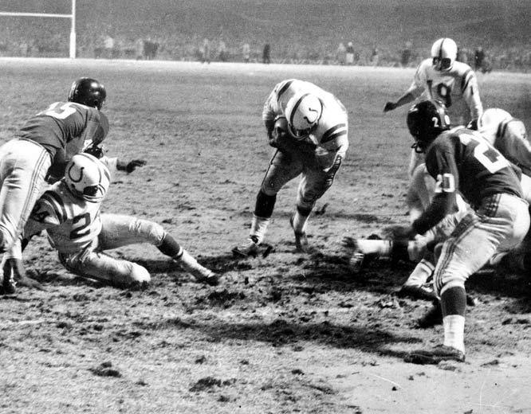
“The Greatest Game Ever Played”
1958 NFL season, the Baltimore Colts and the New York Giants met at Yankee Stadium to determine the league champion.
Tied after 60 minutes of play, it became the first NFL game to go into sudden death overtime.
The final score was Baltimore Colts 23, New York Giants 17.
It was carried live on the NBC television network

Slide 16
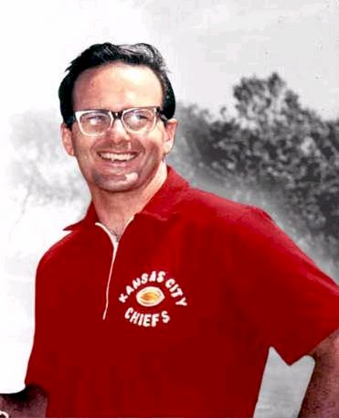
American Football League and merger
In 1959, Dallas, Texas businessman Lamar Hunt led the formation of the rival American Football League,
With the exception of Los Angeles and New York, the AFL avoided placing teams in markets where they directly competed with established NFL franchises.
1960, the AFL began play with eight teams and a double round-robin schedule of fourteen games.

Slide 17
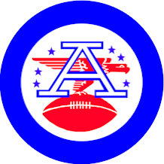
American Football League and merger
The AFL made a concerted effort to attract established talent away from the NFL, signing half of the NFL's first-round draft choices in 1960.
The AFL worked hard to secure top college players, many from sources virtually untapped by the established league
Two of the eight coaches of the Original Eight AFL franchises, Hank Stram (Texans/Chiefs) and Sid Gillman (Chargers) eventually were inducted to the Hall of Fame.
Led by Oakland Raiders owner and AFL commissioner Al Davis, the AFL established a "war chest" to entice top talent with higher pay than they got from the NFL.
Former Green Bay Packers quarterback Babe Parilli became a star for the Boston Patriots during the early years of the AFL, and University of Alabama passer Joe Namath rejected the NFL to play for the New York Jets.
1966, the AFL forced a partial merger with the NFL.
The two leagues agreed to have a common draft and play in a common season-ending championship game, known as the AFL-NFL World Championship.
Two years later, the game's name was changed to the Super Bowl.
1970, the two leagues merged to form a new 26-team league.
The NFL incorporated some of the innovations that led to the AFL's success:
names on player's jerseys
official scoreboard clocks
national television contracts
sharing of gate and broadcasting revenues between home and visiting teams.

Slide 18
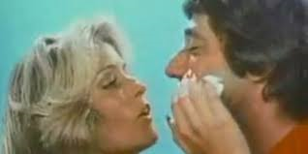
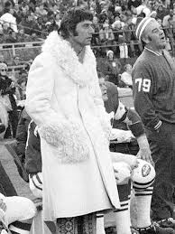
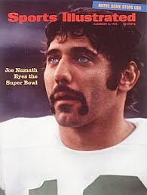
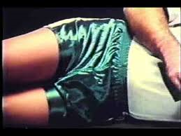
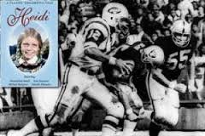
Stars- Joe Namith

Slide 19
The Super Bowl 1967- Current
Steelers- 6
49ers- 5
Cowboys- 5
Packers- 4
Giants- 4
Raiders- 3
Redskins- 3
Patriots- 3
Colts- 2
Dolphins- 2
Broncos- 2
Ravens-1
Jets-1
Buccaneers-1
Saints- 1
Bears- 1
Rams-1
Vikings and Bills are 0-4

Slide 20
Top Dynasties of All time (According to S.I.)
Chicago Bears 1940-43 George Halas' team won three championships and reached the title game in the other year. The Bears' domination is epitomized in their '40 title win when they routed theWashington Redskins 73-0. That made the 37-9 title victory over the New York Giantsthe next year pale in comparison.

Slide 21
Cleveland Browns 1946-55 In a 10-year span, Paul Brown's club won seven titles in the AAFC and the NFL. In '50, when the Browns joined the NFL, their first game was against the defending-champion Eagles. Final score? Browns 35, Eagles 10. Enough said.

Slide 22
Green Bay Packers, 1961-67 Five NFL titles in seven years, including the first two Super Bowls. A larger-than-life coach in Vince Lombardi (and a larger-than-life win in the Ice Bowl, Lombardi's last game as the Packers coach at Lambeau). Twelve Hall of Famers. No wonder the Packers only lost 20 games in that seven-year span.

Slide 23
Miami Dolphins, 1971-73 Three straight Super Bowl appearances, with wins in '72 and '73. Their title success takes a backseat to the undefeated '72 season, the NFL's only perfect mark (17-0). That clinking of champagne glasses each fall comes from Miami when the last undefeated team is finally knocked off. They've downed plenty of bubbly since '72.

Slide 24
Pittsburgh Steelers, 1974-79 Four Super Bowl titles in six years was their net worth. But here's another way to look at it -- had it not been for the Steelers, the Cowboys or the Raiders of that era might have ended up among the top-five NFL dynasties. Ten Steelers, including coach Chuck Noll, eventually ended up in the Hall of Fame. "The Steelers had the best grouping of players in the history of the game," ex-49ers coach Bill Walsh said recently. "No question about it."

Slide 25
Dallas Cowboys 1970-78 In a nine-season span, Tom Landry's Cowboys played in five Super Bowls and won two. Jim O'Brien's field goal denied them in '70, and the Steelers' dynasty cost the Cowboys two other wins. The more impressive number came in playoff appearances -- 18 straight from '66-83.

Slide 26
San Francisco 49ers, 1981-89 Two Super Bowl wins for Joe Montana. Then two more throwing toJerry Rice. Montana's the only three-time Super Bowl MVP; Rice will go down as the league's greatest receiver. The 49ers, of course, were more than just those two. And don't forget the NFL's greatest backup QB, new Hall of Famer Steve Young, who led the 49ers to another Super Bowl in the mid-'90s after Montana's departure.

Slide 27
Buffalo Bills, 1990-93 Can you build a dynasty without actually winning a title? If so, say hello to Marv Levy's Bills. No other team has played in four straight Super Bowls. If victories are required, may we suggest the '64-66 Bills, who reached the AFL title game all three years, winning twice.

Slide 28
Dallas Cowboys 1992-95 Three Super Bowl wins in four years -- and yet the Cowboys will always play the what-if game. What if Jimmy Johnson had remained as coach? And what if Jerry Jones had kept his roster intact instead of seeing it raided by free agency? "I don't believe our team was anywhere near finished doing what we could have done," said QB Troy Aikman.

Slide 29
New England Patriots, 2001-04 Unlike the first four teams, the Pats are not a team that relies on stars. Just seven position players since '01 have made the Pro Bowl (compared to the '90s Cowboys with 17 Pro Bowl performers). Instead, it's the coaching of Bill Belichick and his staff that sets the Pats apart. But the dynasty talk can wait for later. "Not now, not for me," Belichick said.

Slide 30
Football in the Summer?
The months of July and August are terrible months for sports.
NBA finals finish in June
Baseball doesn’t get interesting until September
Golf has one major left, but its still golf
The most interesting thing in sports last July and August was Tom Brady’s Balls.
But could you imagine how awesome your life would be if football were played in June, July and a second Super bowl were played in August!!!
Well it almost happened until someone ruined it!!!!!
Who killed the USFL?

Slide 31
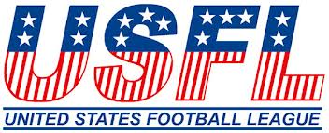
Cheaper Alternative to NFL Franchises the USFL tried to start a Summer Football League with great success drafting top players like Marcus Dupree, Herschel Walker, Steve Young, Reggie White, and Jim Kelly.
League folded after it sued the NFL for breaking anti-trust laws

Slide 32
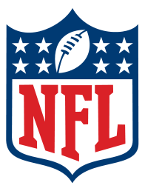
Modern NFL
The NFL continued to adopt innovations of the AFL, including the two-point PAT conversion.
It has expanded several times to its current 32-team membership
The Super Bowl has become more than simply a football championship.
One of the most popular televised events annually, it has become a major source of advertising revenue for the television networks and it serves as a means for advertisers to debut elaborate and expensive commercials for their products.

Slide 33
Modern NFL
One of the things that has marked the modern NFL as different from other major professional sports leagues is the apparent parity between its 32 teams.
From time to time, dominant teams have arisen, the league has been cited as one of the few where every team has a realistic chance of winning the championship from year to year.
The league's complex labor agreement with its players' union, which mandates a hard salary cap and revenue sharing between its clubs, prevents the richest teams from stockpiling the best players and gives even teams in smaller cities such as Green Bay and New Orleans the opportunity to compete for the Super Bowl.
One of the chief architects of this labor agreement was former NFL commissioner Paul Tagliabue, who presided over the league from 1989 to 2006.
In addition to providing parity between the clubs, the current labor contract, established in 1993 and renewed in 1998 and 2006, has kept player salaries low—the lowest among the four major league sports in the United States—and has helped make the NFL the only major American professional sports league since 1993 not to suffer any player strike or work stoppage.

Slide 34
TV and NFL Films and Fantasy Leagues
Football and T.V. were made for each other
NFL Films set out to document the history of the game, making incredibly entertaining and exciting documentaries that increased the popularity of Football.
Following the footsteps of Fantasy Baseball, Fantasy Football allows fans to fake coach players by drafting them onto their own teams.

Slide 35
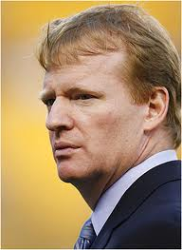
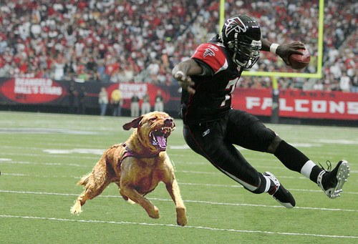
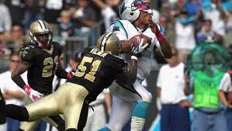
Modern NFL
Since taking over as commissioner before the 2006 season, Roger Goodell has made player conduct and player safety a priority of his office

